Slide 1

FIELD-SCALE AND LABORATORY ASSESSMENT OF PLCC & LCC
Jun Ha Kim

Slide 2

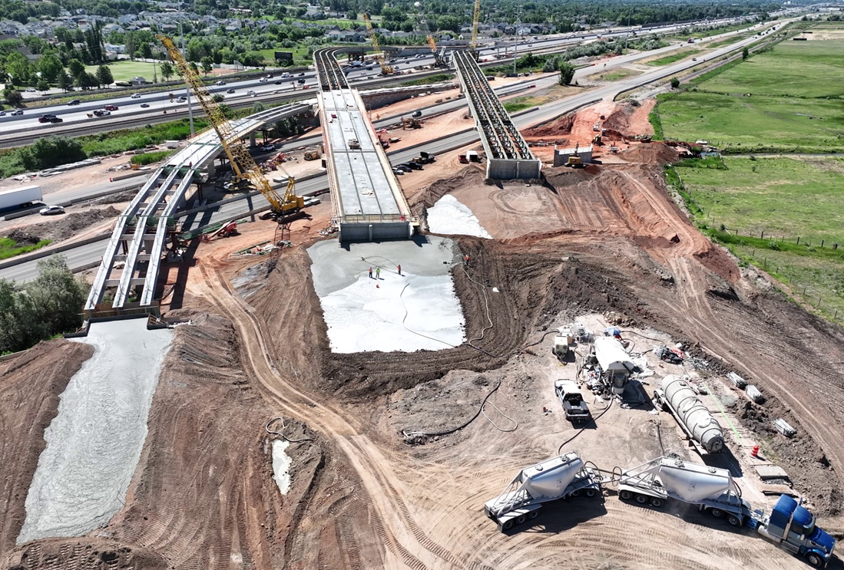
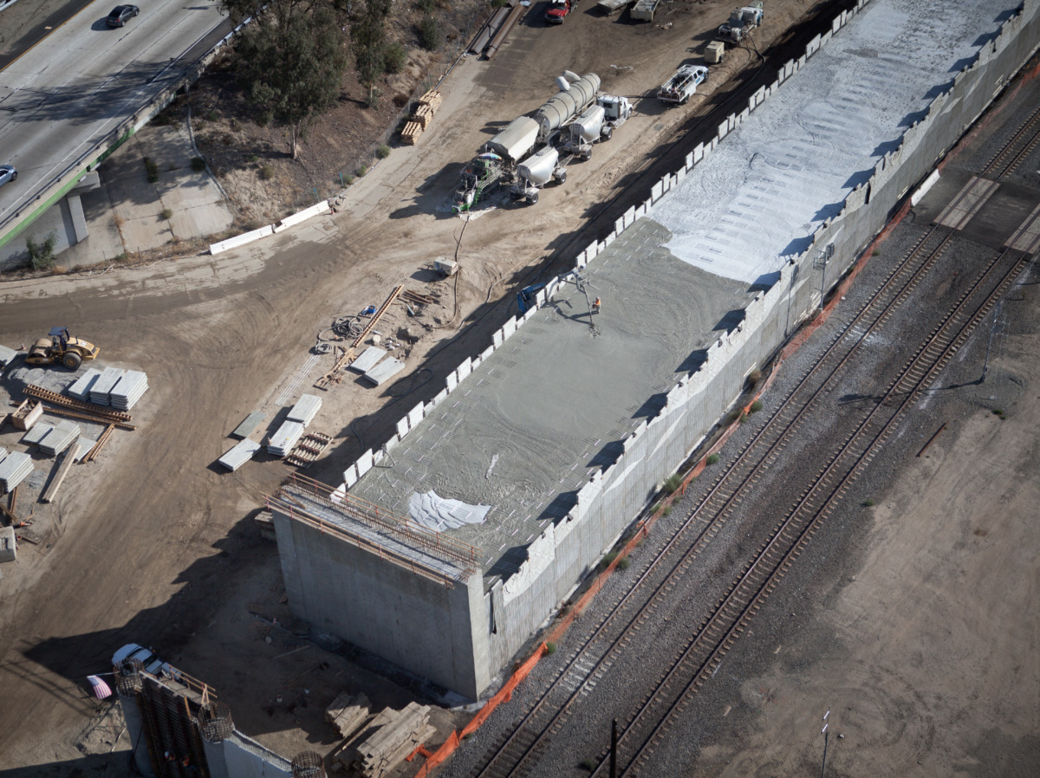
Climate Change & Lightweight Materials
Reduce Urban Flooding from Rising sea levels, heavier rainfall, extreme weather, etc.
Reduce settlement and gravity (i.e., vertical)loads on soft soils
Rapid Construction and seismic load reduction
Urban Flooding, Korea
Settlement Reduction by LCC Installation, West Davis Corridor, Utah
Railroad Construction – Colton Crossing California
Notes:
Let’s begin by looking at the broader context.
As climate change intensifies, we’re seeing more frequent extreme weather events, heavier rainfall, and rising groundwater levels and sea levels. These conditions place growing pressure on infrastructure, especially in soft-soil environments like coastal areas.
To meet these challenges, we need construction materials that can handle increased precipitation, reduce settlement by lowering loads on the soil, and support long-term drainage. In particular, materials that combine high permeability with low density are becoming increasingly important.
Among these materials, Lightweight Cellular Concrete, or LCC, stands out for its unique properties.

Slide 3
Field Installation Lightweight Cellular Concrete (LCC)
Mixing cement, water, and foam
Low density, good workability, easy placement
No compaction required
Commonly used for backfills, embankments, roofing, flooring
Notes:
LCC is a concrete made by mixing cement, water, and foam. The foam creates a uniform air void system, which dramatically reduces the material’s density — often to less than half that of conventional concrete.
Its low density, good workability, and ease of placement make it ideal for applications like backfills, embankments, roofing and flooring applications
It also doesn't require compaction, which saves time and reduces labor on site.

Slide 4
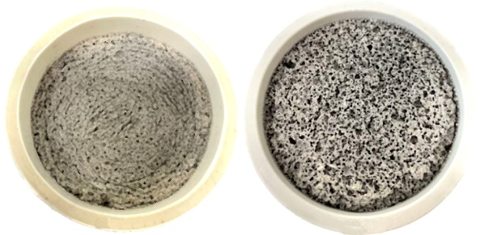
Comparison of LCC and PLCC Fabric
LCC PLCC
This study focuses on the hydraulic properties of Type I Cellular Concrete, also known as low-density cellular concrete (ACI Committee 523, 2006), foamed concrete (Amran et al., 2015, 2022), lightweight foamed concrete (Kozłowski and Kadela, 2018), or aerated concrete (Narayanan and Ramamurthy, 2000
Notes:
Building on LCC, Permeable Lightweight Cellular Concrete (PLCC) was developed to introduce permeability into the material.
It keeps the advantages of LCC — including low density and ease of placement — but is specifically designed with an interconnected pore structure that allows water to pass through.
This engineered porosity enables PLCC to act as both a lightweight fill and a drainage medium, making it especially valuable in applications where infiltration, stormwater management, or pressure relief are critical.

Slide 5
Classification of Permeability (Various Materials)
Relative Permeability | k (m/s) | Geomaterial | Cellular Concrete
Very permeable | k > 1x10⁻² | Gravel, Coarse Gravel | ---
Medium permeability | 1x10⁻⁵ to 1x10⁻³ | Fine Sand, Sand, Coarse Sand | PLCC
Low permeability | 1x10⁻⁵ to 1x10⁻⁷ | Silty Sand, Silty-Clayey Sand | LCC
Very low permeability | 1x10⁻⁷ to 1x10⁻⁹ | Fine Sandstone, Silt | LCC
Impermeable | k < 1x10⁻⁹ | Clay, Mudstone | Structural Concrete
Notes:
Building on LCC, Permeable Lightweight Cellular Concrete (PLCC) was developed to introduce permeability into the material.
It keeps the advantages of LCC — including low density and ease of placement — but is specifically designed with an interconnected pore structure that allows water to pass through.
This engineered porosity enables PLCC to act as both a lightweight fill and a drainage medium, making it especially valuable in applications where infiltration, stormwater management, or pressure relief are critical.

Slide 6
Research Objectives
Increase the Data for hydraulic conductivity (K) for LCC and PLCC
  Limited Exists
Evaluate specimen size effects on K
  PLCC 6”x12” specimens (prior research was done only on 3”x6” specimens)
  LCC from double ring infiltrometer (previously 3”x6” specimens)
Study effects of foam type, density, surface treatment of specimens on K
Make initial recommendations for design and construction of PLCC and LCC systems
Notes:
This research was motivated by the need to better understand how foam type, material density, and surface condition influence the hydraulic performance of lightweight cellular concretes.
Although both LCC and PLCC are used in geotechnical and infrastructure applications, their permeability characteristics can change depending on formulation and densities.
Yet, there is limited experiment data in larger scale tests on these concretes.
Specifically, this study aimed to:
Compare the infiltration behavior of LCC and PLCC
Investigate how changes in foam agent, density, and surface texture affect permeability.
Evaluate performance through both laboratory-scale cylinder testing and field-scale infiltration testing
By doing so, this research helps fill a gap in the current literature and provides practical data for designing with cellular concrete in real-world drainage and fill applications.

Slide 7
Research Plan
Phase 1: Lab-Scale permeability test (PLCC)
Phase 2: Field-Scale Double-Ring Infiltrometer (Concrete Sand and LCC)
Phase 3: Data Reduction and Evaluations
Phase 4: Comparison of Results and Recommendations
Notes:
To achieve the objectives, the study was organized into three phases, each designed to examine a different aspect of permeability under controlled conditions:
Phase 1 – Laboratory Testing on PLCC:
Constant-head permeability tests were performed on PLCC cylinder specimens.
This allowed us to evaluate the relationship between density and hydraulic conductivity under ideal, small-scale conditions.
Phase 2 – Field Setup Validation with Sand:
Before conducting field-scale double-ring infiltrometer tests on LCC, an infiltration test using clean sand was carried out.
This served as a control test to confirm the accuracy and reliability of the large-scale test setup, including the Mariotte bottle and double-ring infiltrometer assembly.
Phase 3 – Field Testing on LCC:
The double-ring infiltrometer test was performed on a large-diameter LCC specimen placed in a 4-ft tank.
The goal was to evaluate field-scale permeability, including the effects of surface condition, and compare it with laboratory PLCC results.

Slide 8
Laboratory Preparation of Lightweight Cellular Concrete
Measuring Foaming Agent Foam Generation Device Foam and Concrete Mixing Sample Pouring
Notes:
Building on LCC, Permeable Lightweight Cellular Concrete (PLCC) was developed to introduce permeability into the material.
It keeps the advantages of LCC — including low density and ease of placement — but is specifically designed with an interconnected pore structure that allows water to pass through.
This engineered porosity enables PLCC to act as both a lightweight fill and a drainage medium, making it especially valuable in applications where infiltration, stormwater management, or pressure relief are critical.

Slide 9
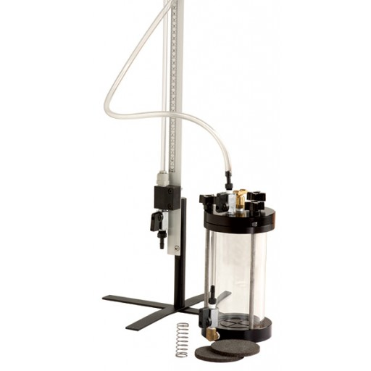
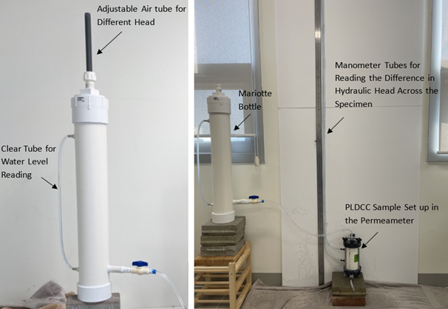
Rigid Wall Permeameter Testing
ASTM D2434-19. Standard Test Method for Permeability of Granular Soils (Constant Head). ASTM International.
Notes:
Building on LCC, Permeable Lightweight Cellular Concrete (PLCC) was developed to introduce permeability into the material.
It keeps the advantages of LCC — including low density and ease of placement — but is specifically designed with an interconnected pore structure that allows water to pass through.
This engineered porosity enables PLCC to act as both a lightweight fill and a drainage medium, making it especially valuable in applications where infiltration, stormwater management, or pressure relief are critical.

Slide 10
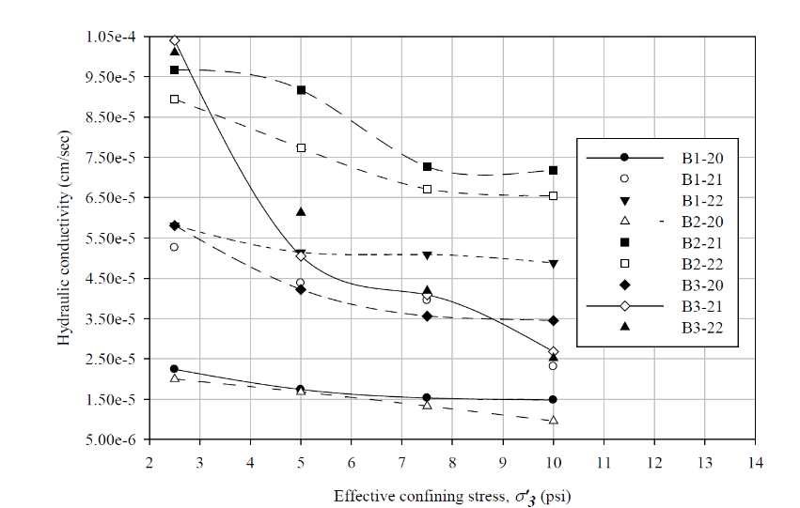
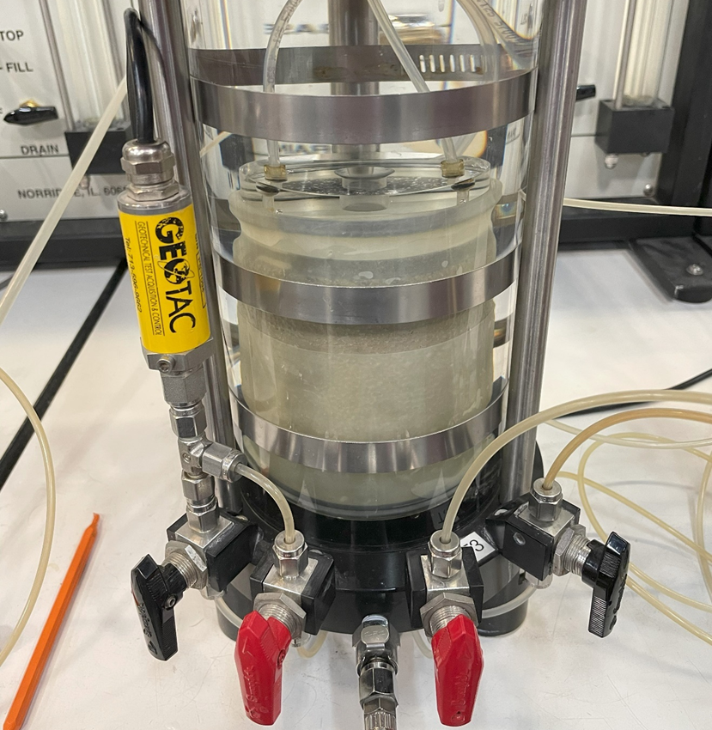
Flexible Wall Permeameter Testing
Flexible Cell Test Chamber (Seely, 2024)
ASTM D18 Committee. 2016. D5084-16a - Flexible Wall Permeameter. ASTM International.
LCC permeability (Seely, 2024)
Notes:
Building on LCC, Permeable Lightweight Cellular Concrete (PLCC) was developed to introduce permeability into the material.
It keeps the advantages of LCC — including low density and ease of placement — but is specifically designed with an interconnected pore structure that allows water to pass through.
This engineered porosity enables PLCC to act as both a lightweight fill and a drainage medium, making it especially valuable in applications where infiltration, stormwater management, or pressure relief are critical.

Slide 11
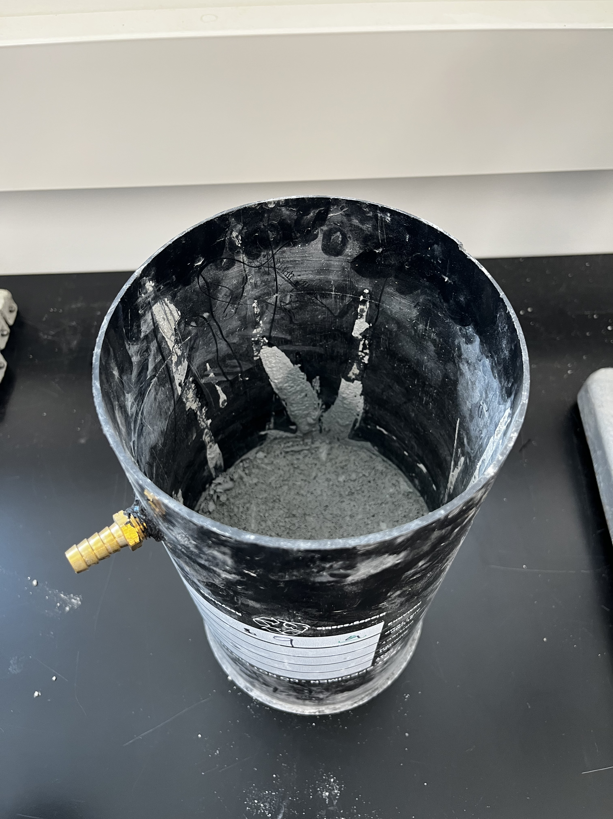
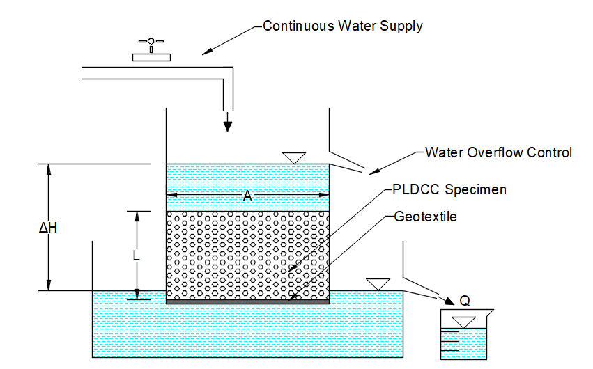

Cylinder Sample Preparation (PLCC)
Water-to-cement ratio = 0.55
Target densities: 24–32 PCF
Foam agent: AQUAERIX-LB
Darcy’s law application
$q=k∙i∙A$
$i=∆h/L$
$q=Q/T$
Notes:
In Phase 1, PLCC cylinder specimens were prepared in the lab to evaluate permeability under controlled conditions.
A recommended water-to-cement (w/c) ratio of 0.55 was used for consistency.
The target densities ranged from 24 to 32 pounds per cubic foot (PCF), which represents the practical range for balancing strength and permeability in PLCC.
The foaming agent used was AQUAERIX-LB, which is known to produce an open-pore structure suitable for permeability-focused applications.
Foam was pre-generated and mixed gradually into the cement slurry until the desired density was reached.
Each specimen was cast in a 6 inches in diameter and 12 inches in height cylinder mold.
Only the lower portion of the mold was filled to allow for vertical permeability testing through a defined cross-sectional area.
After curing, the bottom surface of each sample was left open, enabling unconfined vertical flow during testing.

Slide 12
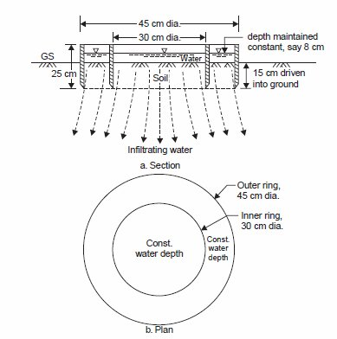
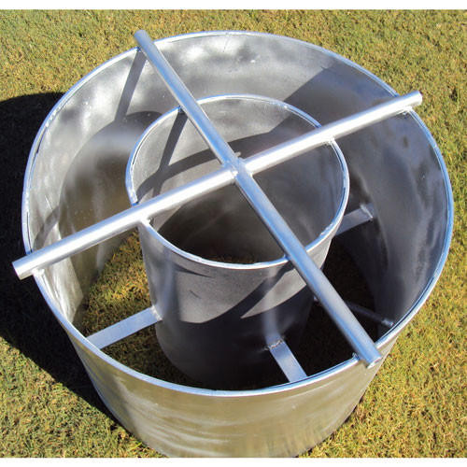
Double-Ring Infiltrometer Test Setup (Sand & LCC)
Large-scale 4-ft diameter tank setup
ASTM D3385-18
Constant head maintained during infiltration
Mariotte Tube
60 cm
2-foot outer ring
1-foot inner ring
Notes:
To simulate field-scale conditions, a double-ring infiltrometer test was conducted on a large specimen placed in a 4-feet diameter tank.
The setup consisted of two concentric rings — an inner and outer ring — installed on top of the LCC layer.
This configuration helps control lateral flow and ensures vertical infiltration through the center test area.
To maintain a consistent hydraulic head during the test, a Mariotte bottle was used to supply water at a controlled and constant rate.
The inner ring was monitored to measure infiltration, while the outer ring helped maintain symmetric flow conditions and reduced edge effects.

Slide 13
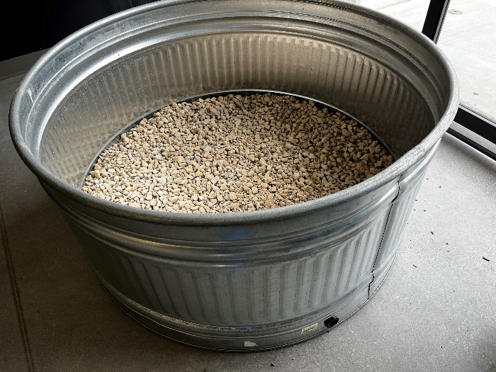
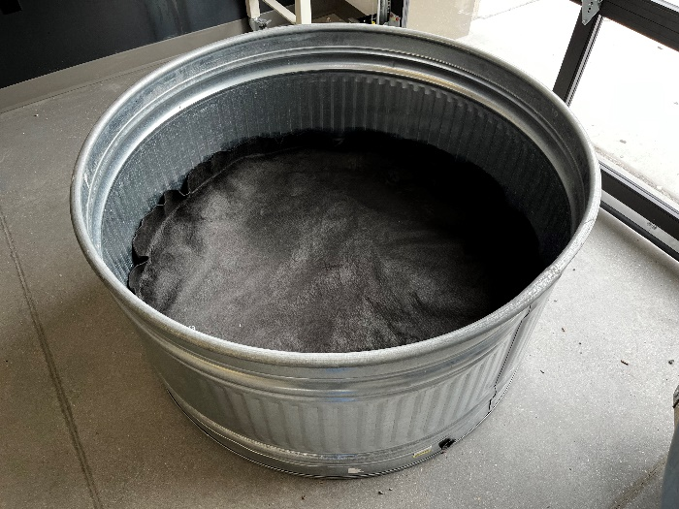
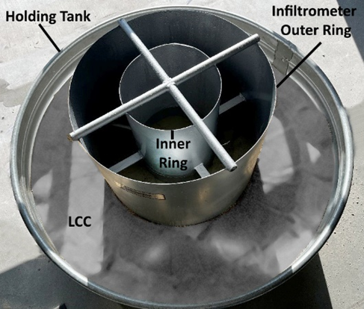
Double-Ring Infiltrometer Test Setup (Sand & LCC)
Notes:
Top of gravel base – geotextile separator – 1-foot-thick layer of sand & LCC
Pre-wetting and saturation steps to eliminate air pockets before measurement
This field-scale configuration allowed us to assess the hydraulic performance of LCC under more realistic conditions

Slide 14
Concrete Sand Validation Test for DRI Test
Infiltration rates matched standard values
Confirmed reliability of test setup (6.65E-05 m/s) (med. permeability
K (m/s)
Trial 2 | Trial 2 | Trial 3 | Trial 4 | Trial 5 | Trial 6
7.07E-05 | 7.09E-05 | 5.71E-05 | 6.57E-05 | 7.01E-05 | 6.46E-05
?
Notes:
Before performing the double-ring infiltrometer test on LCC, a preliminary infiltration trial was conducted using clean, uniformly graded sand.
This test served to validate the accuracy and consistency of the large-scale experimental setup, including the Mariotte bottle, ring assembly, and measurement process.
The measured infiltration rate for the sand layer was approximately 6.65 × 10⁻⁵ meters per second,
which is very close to published permeability values for uniformly graded sands — typically ranging from 10⁻⁴ to 10⁻⁶ m/s.
CONFIRMS
The Mariotte bottle maintained a consistent head,
The flow path was properly directed, and
The setup was capable of producing reliable and interpretable results.
By confirming that the system performed as expected with a standard material, confidence was established for interpreting the results of the subsequent LCC test.

Slide 15
Constant-Head Test Results (PLCC)
High repeatability
Permeability Vs density
k = 1.16 × 10⁻³ m/s
Notes:
The constant-head tests on PLCC specimens came out to be consistent and repeatable results.
A clear trend was observed: as density increased, permeability decreased, which aligns with the expected inverse relationship between void ratio and flow capacity.
The average measured permeability for PLCC samples was approximately 1.16 × 10⁻³ meters per second, indicating a
highly porous and well-connected internal structure.
This supports the notion that PLCC, when properly formulated, can achieve infiltration rates comparable to traditional drainage materials.
These results demonstrate that with appropriate foam agent, density, and mixing, PLCC can be manufactured to achieve predictable and desirable hydraulic behavior.

Slide 16
Double-Ring Infiltrometer on LCC
As-cast surface: limited permeability
k = 2.43 × 10⁻⁶ m/s
¼ inch scraped for porous texture
Scraped surface: lower permeability
k = 1.15 × 10⁻⁶ m/s
Notes:
In the field-scale test, the LCC surface initially appeared dense and non-porous after drying.
There were no visible infiltration pathways, and the as-cast surface showed limited water penetration.
The initial infiltration rate measured through this surface was approximately 2.43 × 10⁻⁶ meters per second,
indicating very low permeability, even lower than expected for a lightweight material.
To evaluate the effect of surface texture, the top ¼ inch of the LCC surface was manually removed using a scraper, EXPOSING a more porous-looking inner layer.
However, contrary to initial expectations, the infiltration rate decreased further to 1.15 × 10⁻⁶ meters per second after scraping.

Slide 17
Permeability Comparison
PLCC: 1.16 × 10⁻³ m/s
LCC: 2.43 × 10⁻⁶ m/s
Foam agent and pore structure is critical
 | Non-porous Texture | Porous Texture | Porous Texture (2nd Trial)
K (m/s) | 2.43E-06 | 1.12E-06 | 1.15E-06
Notes:
PLCC: this level per. Is consistent with high-perm. Materials. Sandy, soils, and open aggregates. Serve effectively as drainage-capable lightweight fill
LCC: significantly lower perm. Low perm. Soils such as silt, clay, despite it’s visual porosity.
Difference is 3 ORDERS OF MAGNITUDE showing the critical role of foam agent and pore structure.

Slide 18
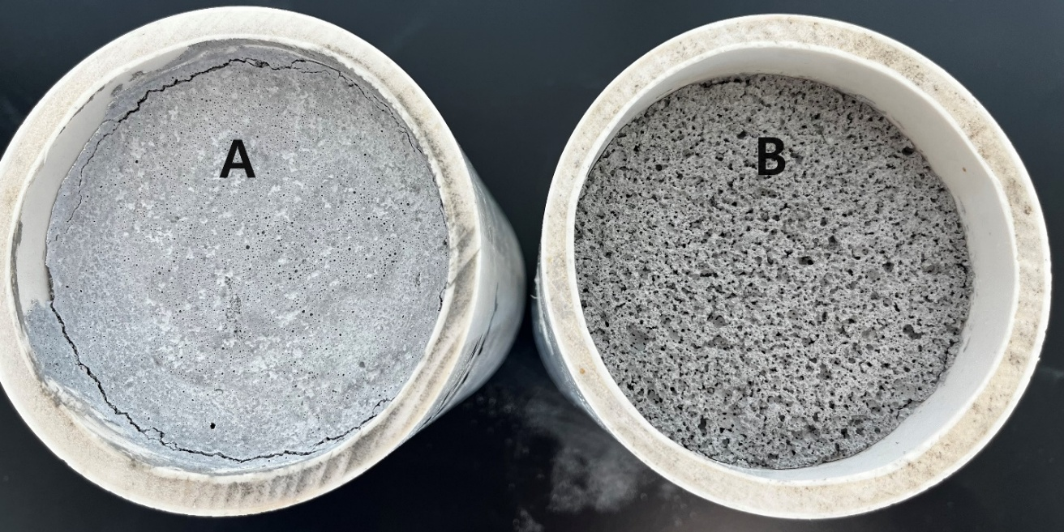
Foam Agent Influence
AQUAERIX-LB: open-pore structure
AQUAERIX: dense, closed-pore structure
Notes:
A major factor behind the permeability difference between PLCC and LCC is the foam agent used during production.
PLCC samples were produced using AQUAERIX-LB, a foam designed to generate a more open and interconnected pore network.
This structure allows continuous water flow through the matrix, resulting in high permeability and consistent drainage behavior.
On the other hand, the LCC used in the field test was made with AQUAERIX, a different foam agent.
This agent tends to produce smaller, more closed-cell pores and a denser internal structure, which restricts water movement even when the material appears visually porous.
This shows that: Foam chemistry directly affects pore structure — including void size, shape, and connectivity
In short, foam agent is a critical design variable that determines whether a lightweight concrete will be permeable or impermeable.

Slide 19
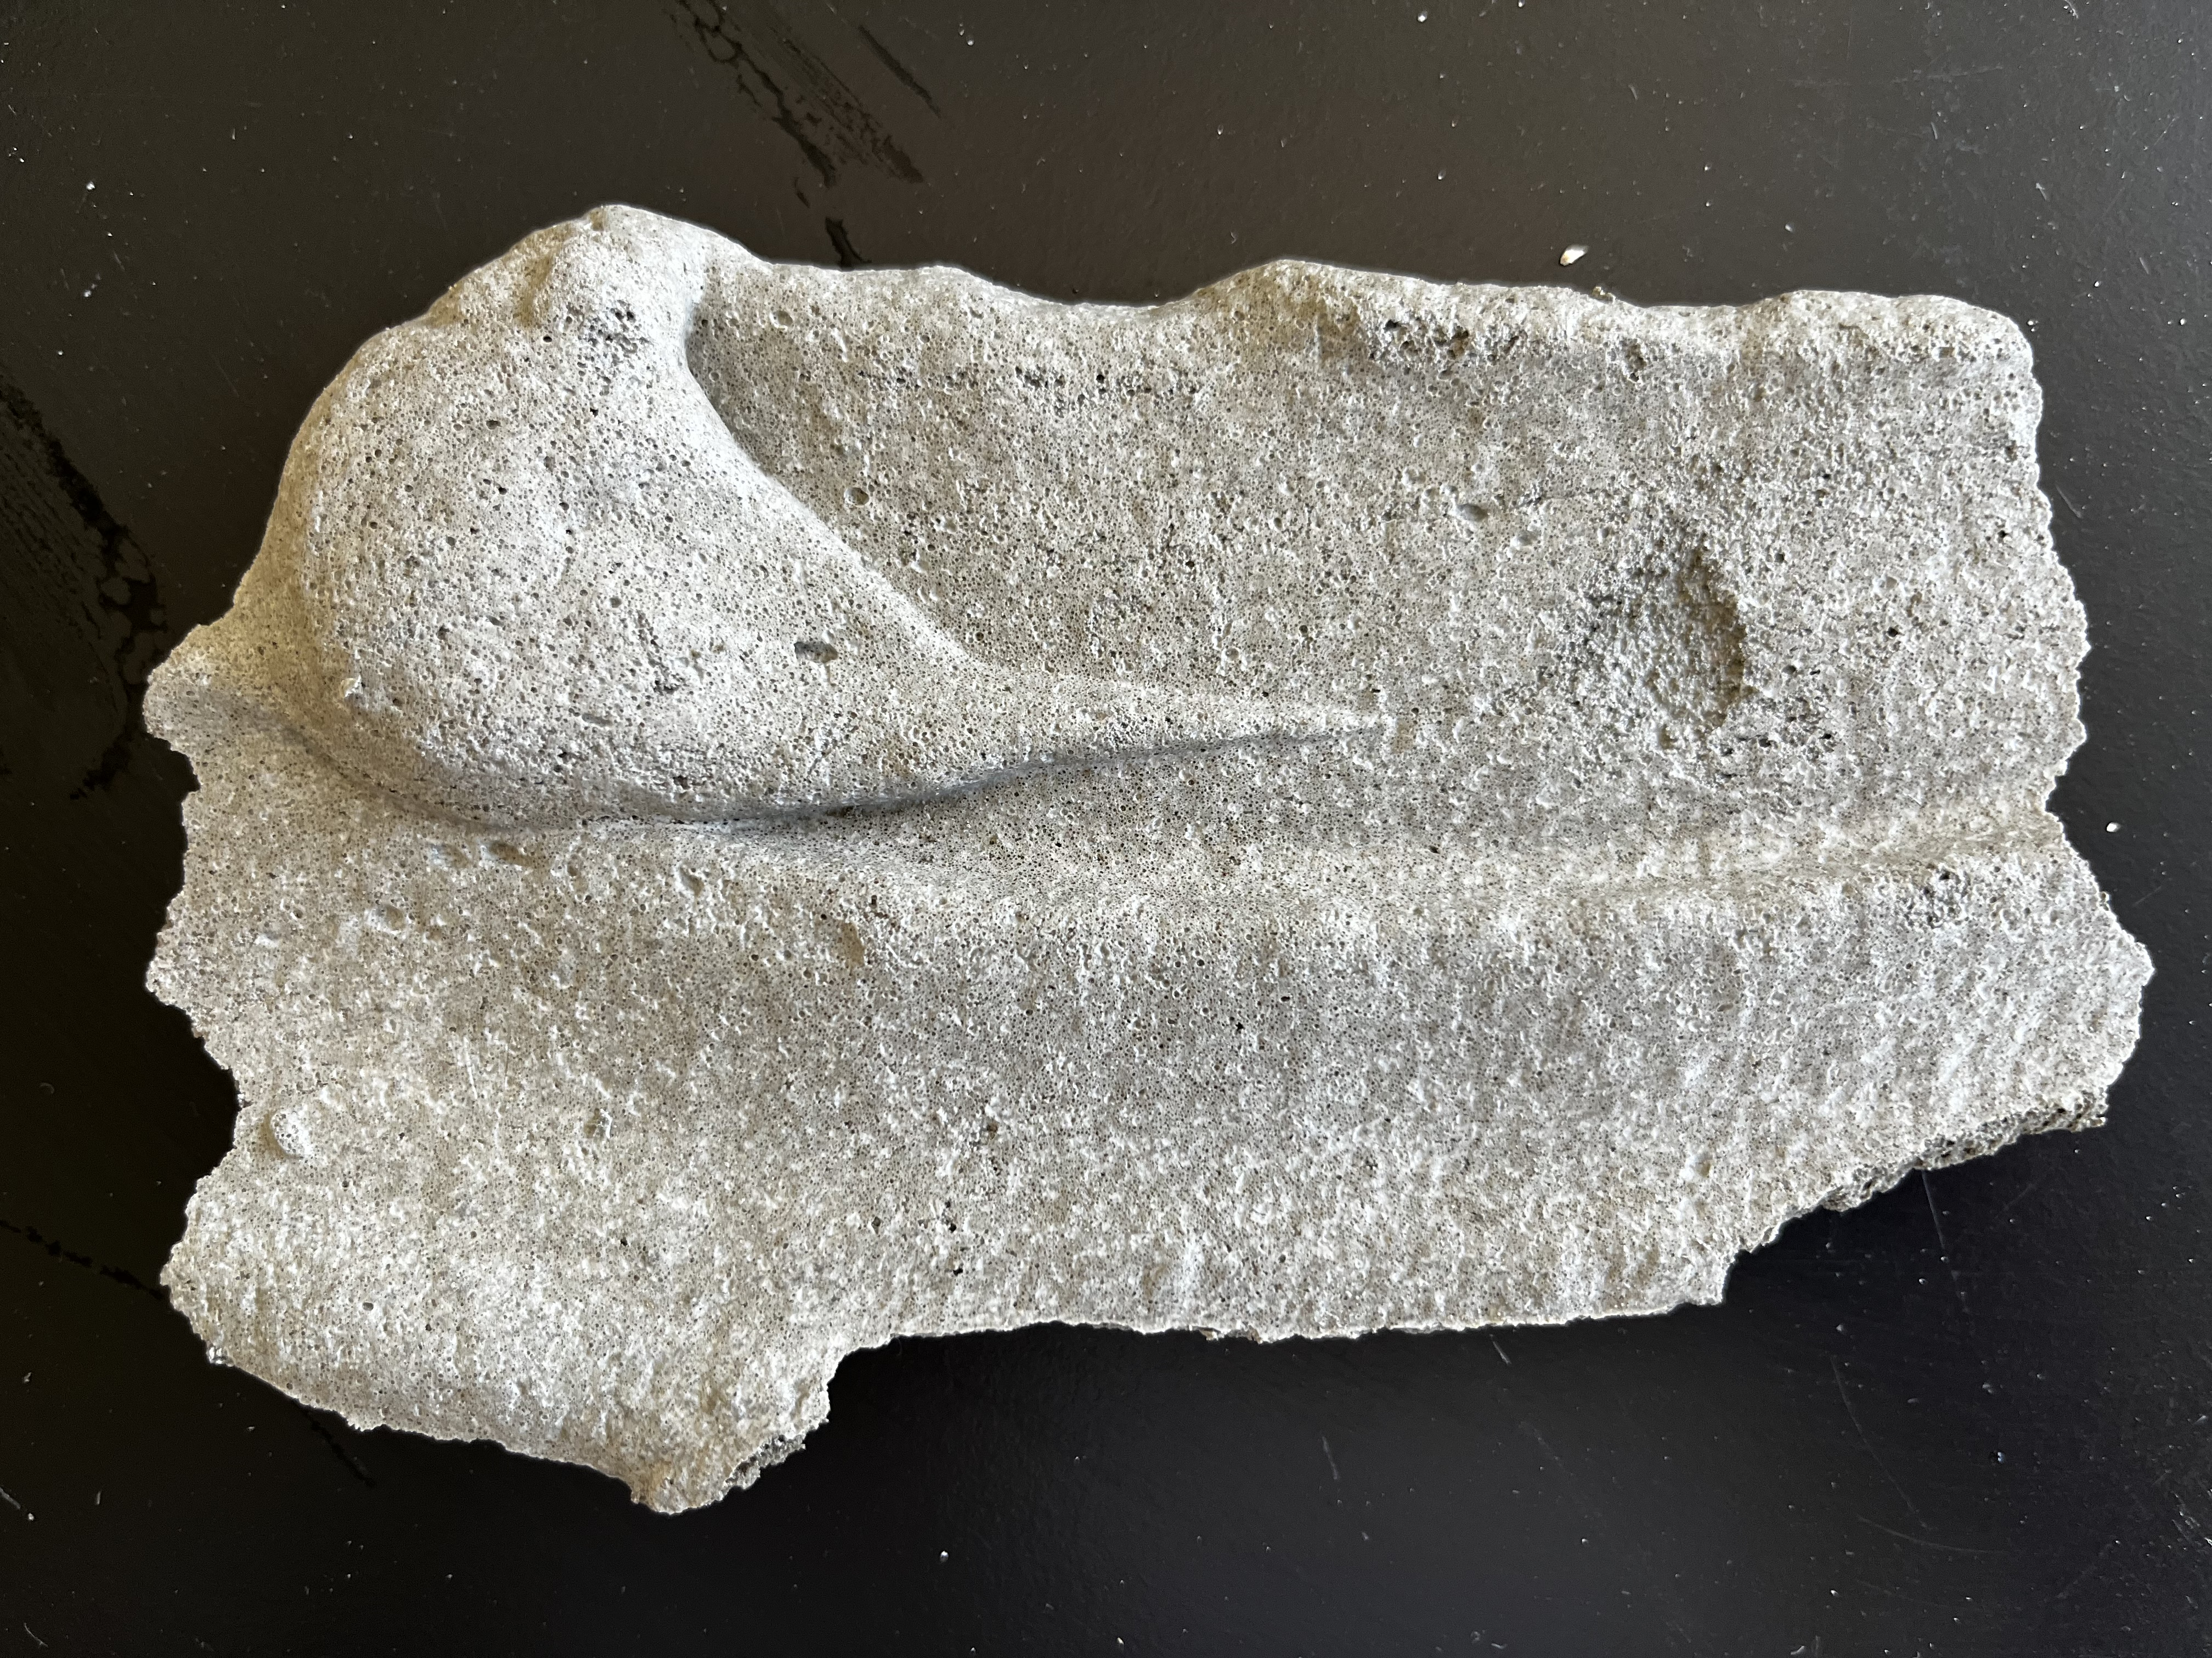
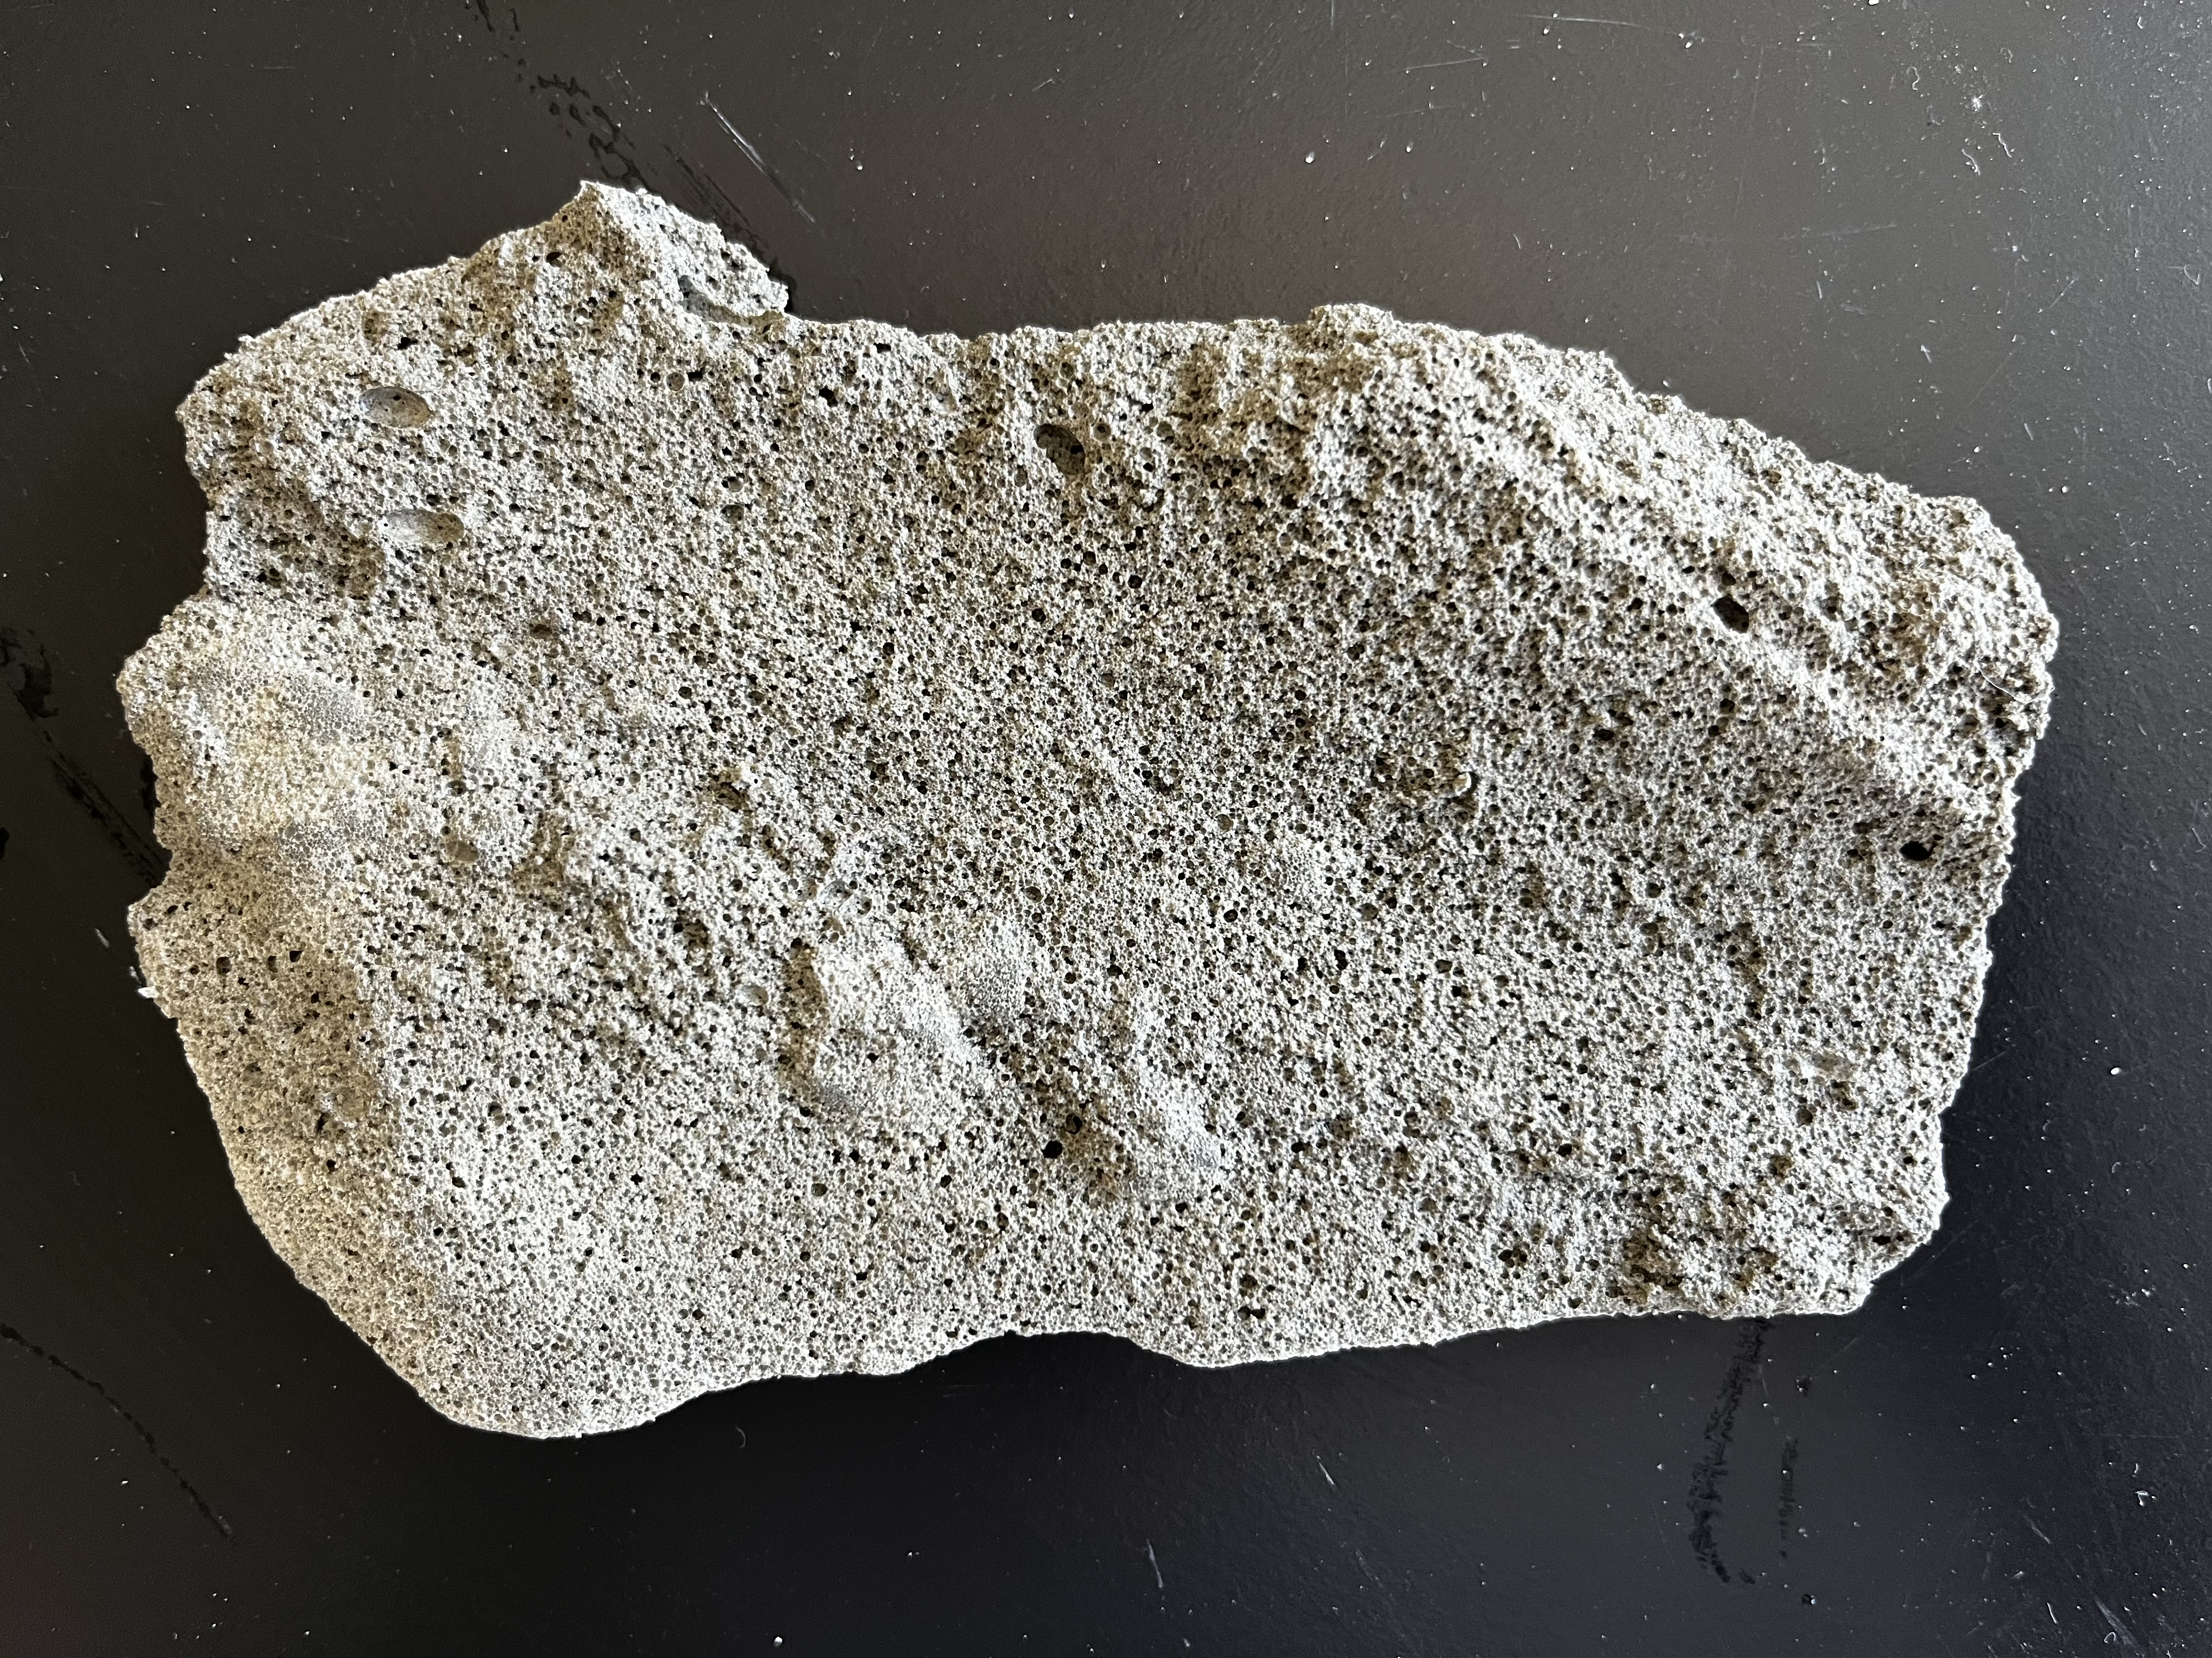
Surface Texture Effects
Scraping may disrupt flow paths
Importance of internal pore continuity
Notes:
Another factor to be considered..
Unexpectedly the outcome from the field scale test showed that removing the surface of the LCC did not improve permeability — it actually reduced it.
This result challenges the common assumption that exposing internal pores or roughening the surface will enhance water infiltration.
several possible reasons may explain :
Scraping could have disrupted flow paths, may have introduced debris or surface particles that partially clogged the newly exposed pores, especially if the underlying structure was not well connected.
Second, although visually more porous — lacked continuous pore connectivity, which is essential for water to pass through.
These findings suggest that:
surface treatment strategies, such as scraping or roughening, must be carefully evaluated on a case-by-case basis

Slide 20
Practical Applications
Notes:
Based on the findings from this study, LCC and PLCC offer distinct advantages in different types of applications — depending on WHETHER permeability is required.
PLCC is best suited for:
Drainage fills for flood-mitigation
Stormwater management systems, where infiltration and weight reduction are both critical
Its high permeability and lightweight nature make it an excellent material where increased rainfall and drainage challenges are of issue due to climate change.
LCC, on the other hand, is more appropriate where low permeability is desired, such as:
Dikes and roadways
Lightweight embankments over soft or compressible soils
LCC’s denser internal structure allows it to resist moisture while still providing significant weight savings.
Ultimately, understanding the differences between PLCC and LCC enables appropriate material selections that match hydraulic performance needs.

Slide 21
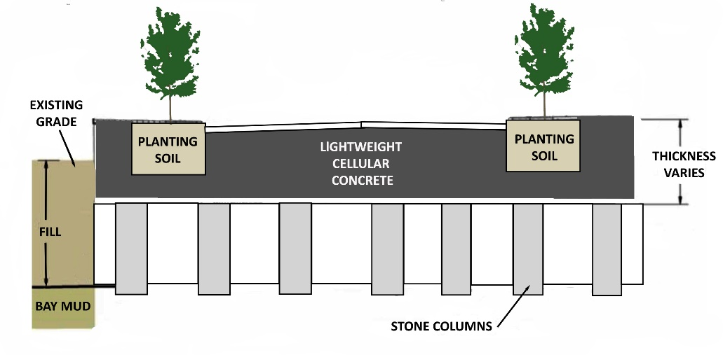
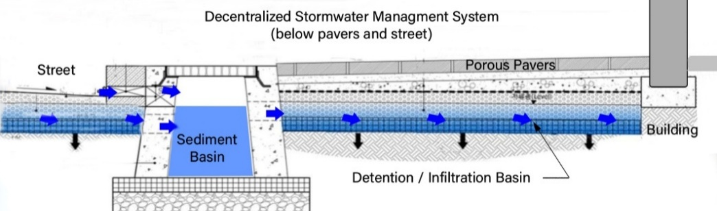
Recommendations
PLCC has medium perm. Can act as drain and storage medium.
LCC is low perm and can act as a hydraulic barrier
LCC lab versus field scale effects
foam type (important and supplier specific), density (appears to affect K), surface treatment (also affect K (negatively – damage) of specimens on K
PLCC: Drainage, Flood mitigation, Stormwater management systems
LCC: Dikes and roadways, Lightweight embankments over soft or compressible soils
Selection understanding the differences
LCC compressible soil application
PLCC Stormwater and Infiltration System

Slide 22
Thank You
Q&A

