Slide 1

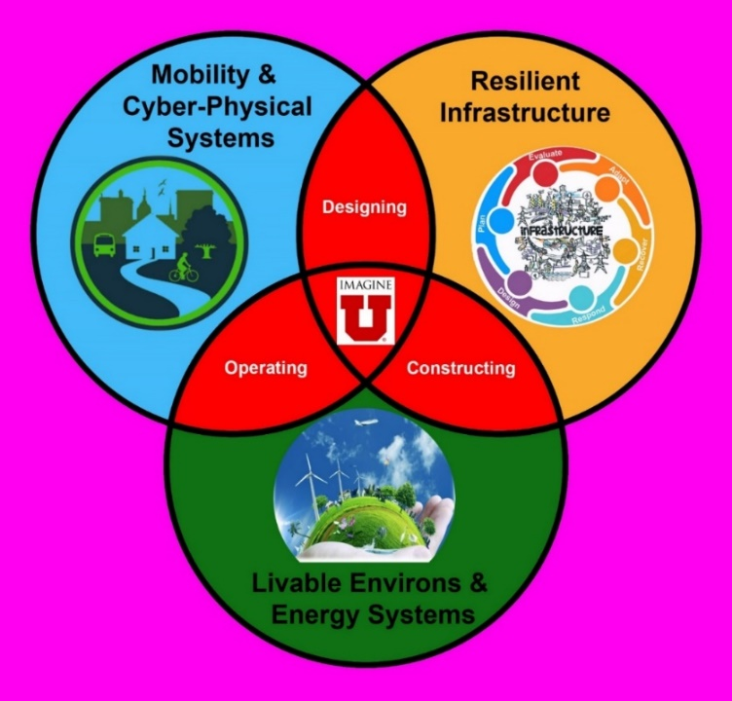

Learning to Ask the Right Questions – Global Warming Impacts to Infrastructure
Smart &Sustainable Communities

Slide 2
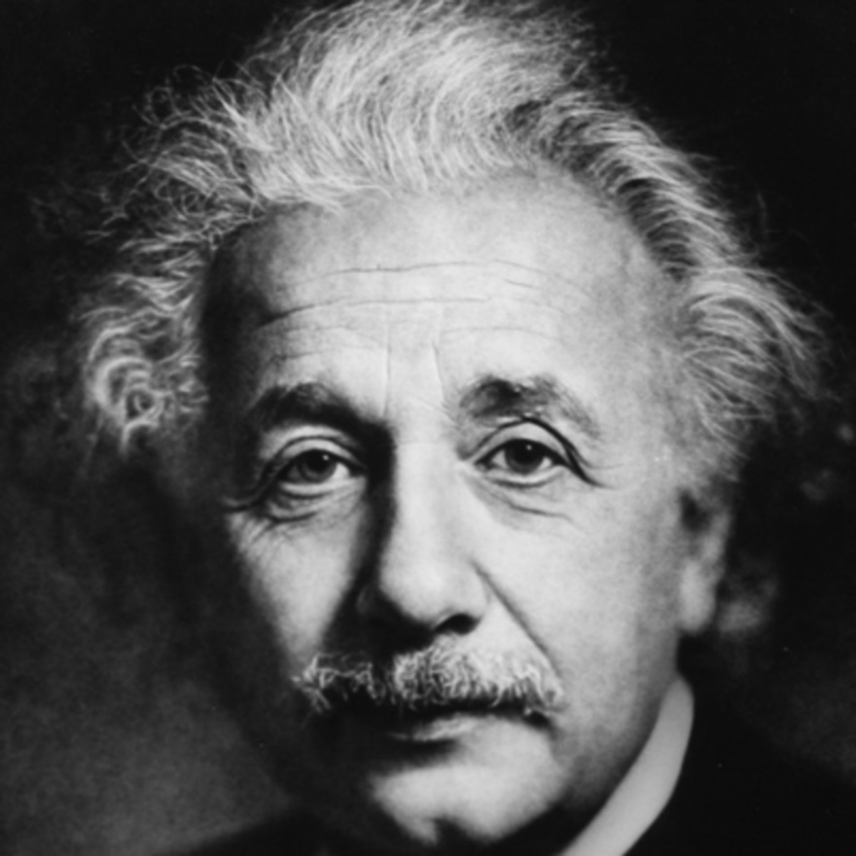
Albert Einstein and Questioning
“If I had an hour to solve a problem and my life depended on the solution, I would spend the first 55 minutes determining the proper question to ask… for once I know the proper question, I could solve the problem in less than five minutes.”

Slide 3

Questioning & Problem Solving
Question Formulate Generate Implement

Slide 4

Asking the Right Questions
Leads to the ability to:
Create solutions
Make decisions
Formulate plans

Slide 5
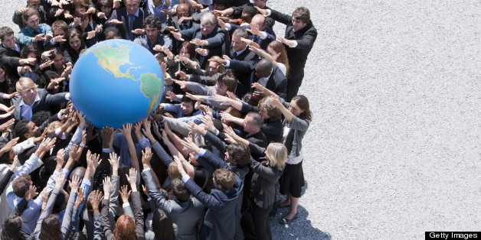
Solving Complex Problems Takes Teamwork
“If you want to go fast, go alone. If you want to go far go together.”
African proverb

Slide 6

What Are the Right Questions About Climate Change?

Slide 7
What Are the Right Questions About Climate Change?
Is climate change really occurring?
What is climate change doing to the environment?
What is climate change doing to our infrastructure?
What can SOCIETY DUE TO slow climate change?
What can I do as an INDIVIDUAL to slow climate change?

Slide 8
Is climate change really occurring?
Scientists have a moral obligation to clearly warn humanity of any catastrophic threat and to "tell it like it is." On the basis of this obligation and the graphical indicators presented below, we declare, with more than 11,000 scientist signatories from around the world, clearly and unequiv- ocally that planet Earth is facing a climate emergency.

Slide 9
What is climate change doing to
the environment?
Especially disturbing are concurrent trends in the vital signs of climatic impacts. Three abundant atmospheric GHGs (C02, methane, and nitrous oxide) continue to increase, as does global surface temperature. Globally, ice has been rapidly disappearing, evidenced by declining trends in minimum summer Arctic sea ice, Greenland and Antarctic ice sheets, and glacier thickness worldwide. Ocean heat content, ocean acidity, sea level, area burned in the United States, and extreme weather and associated damage costs have all been trending upward; Climate change is predicted to greatly affect marine, freshwater, and terrestrial life, from plankton and corals to fishes and forests (IPCC 2018, 2019). These issues highlight the urgent need for action.

Slide 10
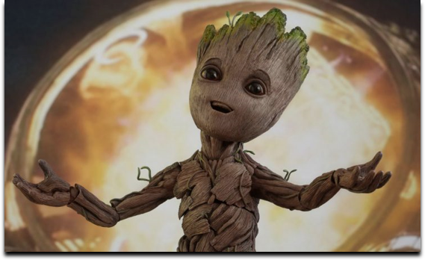
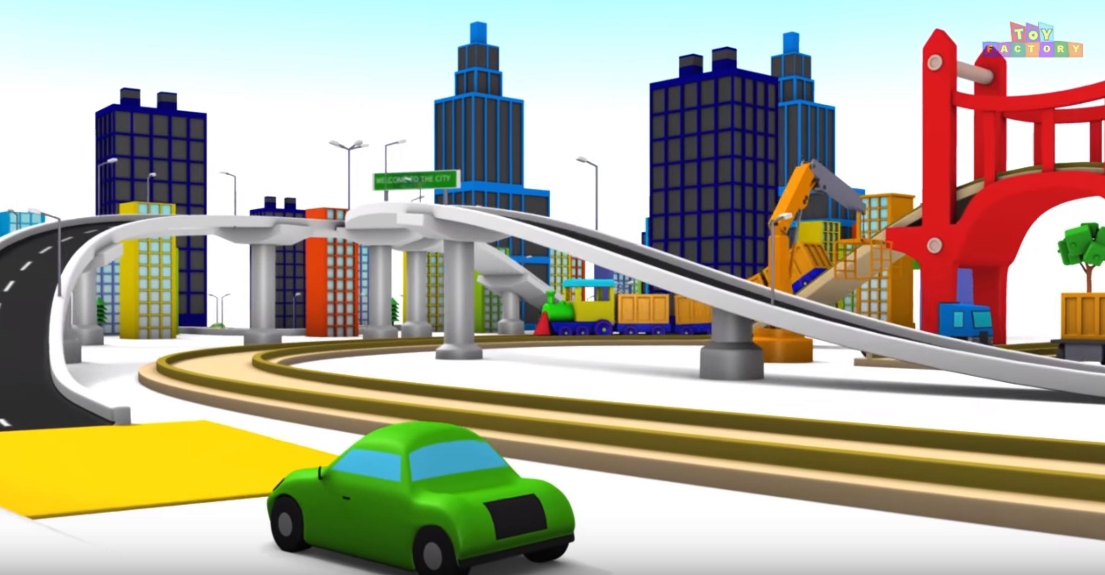
What is climate change doing to infrastructure?
Civil and Environmental Engineers are Guardians of Infrastructure

Slide 11
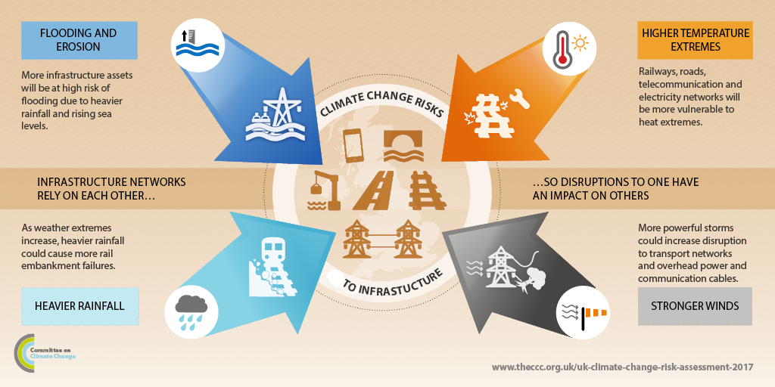
Climate Change Impacts to Infrastructure

Slide 12
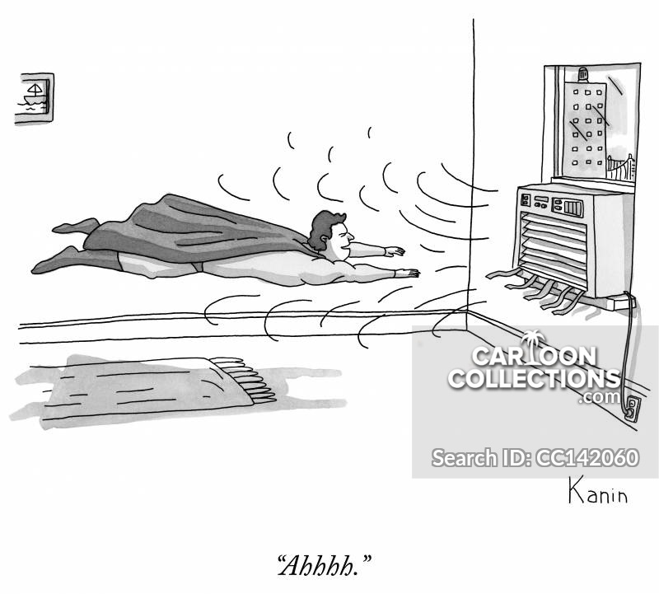
High Temperature Extremes
It takes a lot of energy to cool our living spaces

Slide 13
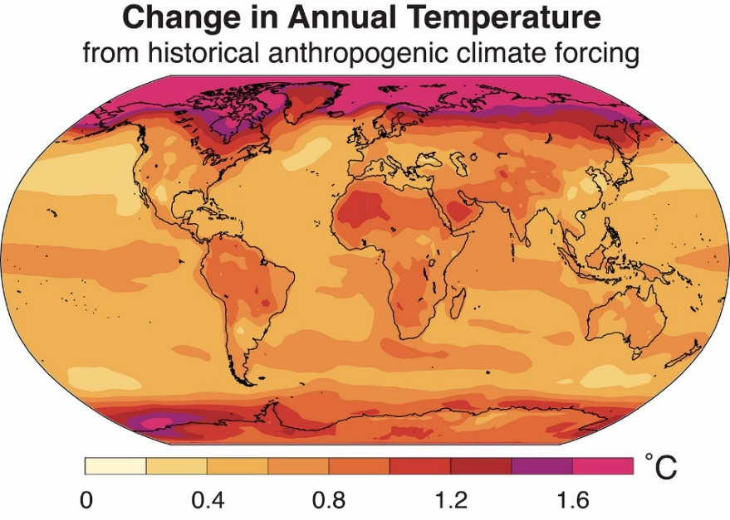
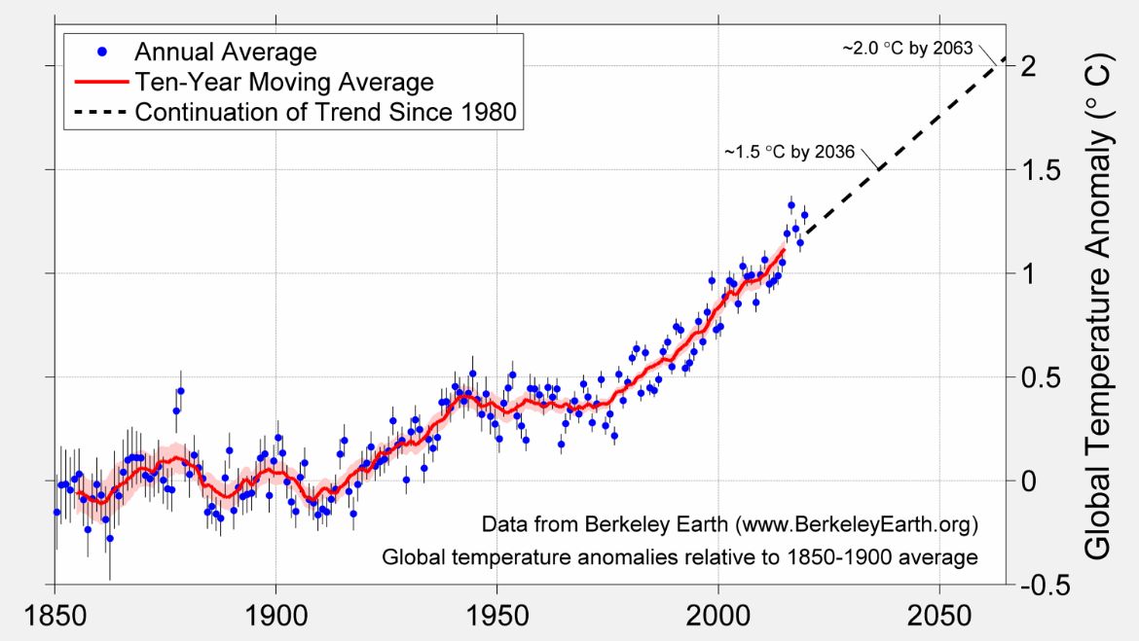
High Temperature Extremes
https://news.stanford.edu/press-releases/2019/04/22/climate-change-wnomic-inequality/

Slide 14
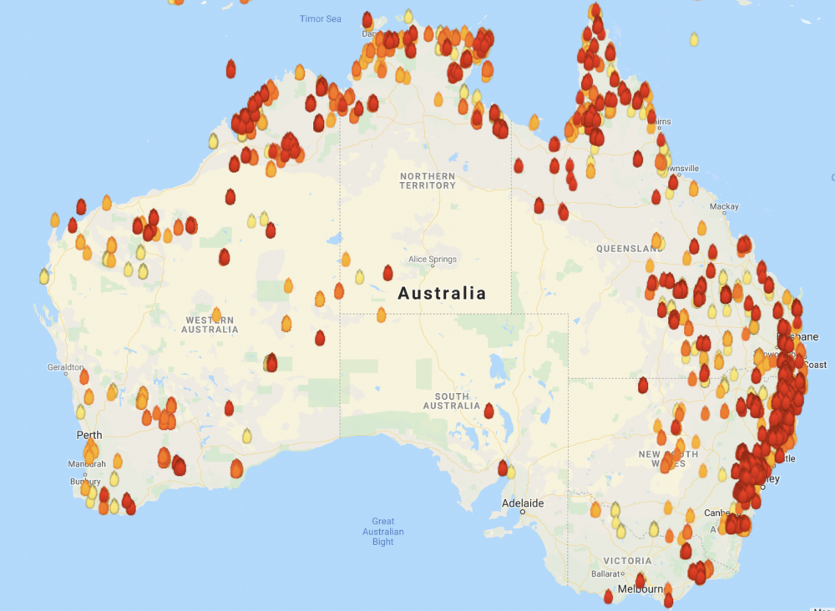
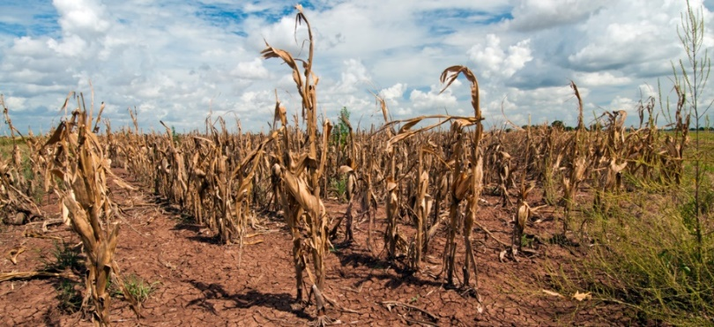
High Temperature Extremes and Drought

Slide 15
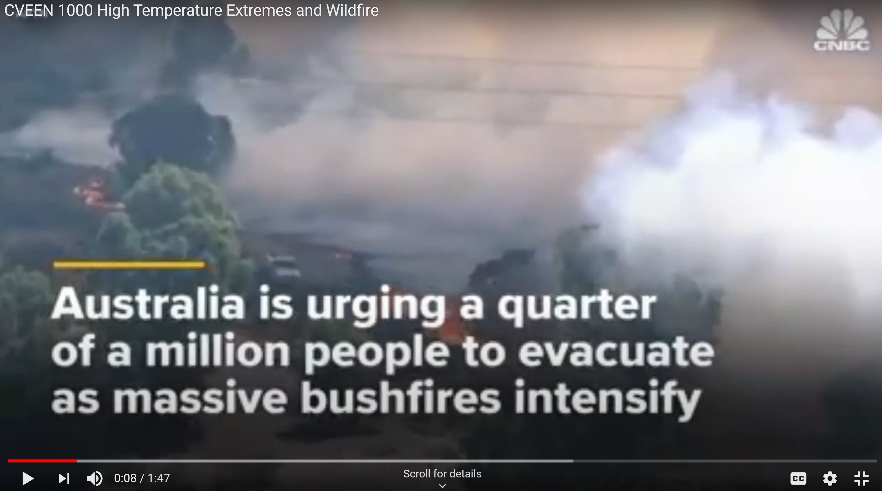
High Temperature Extremes and Wildfires
https://youtu.be/iS_111GVbuE

Slide 16
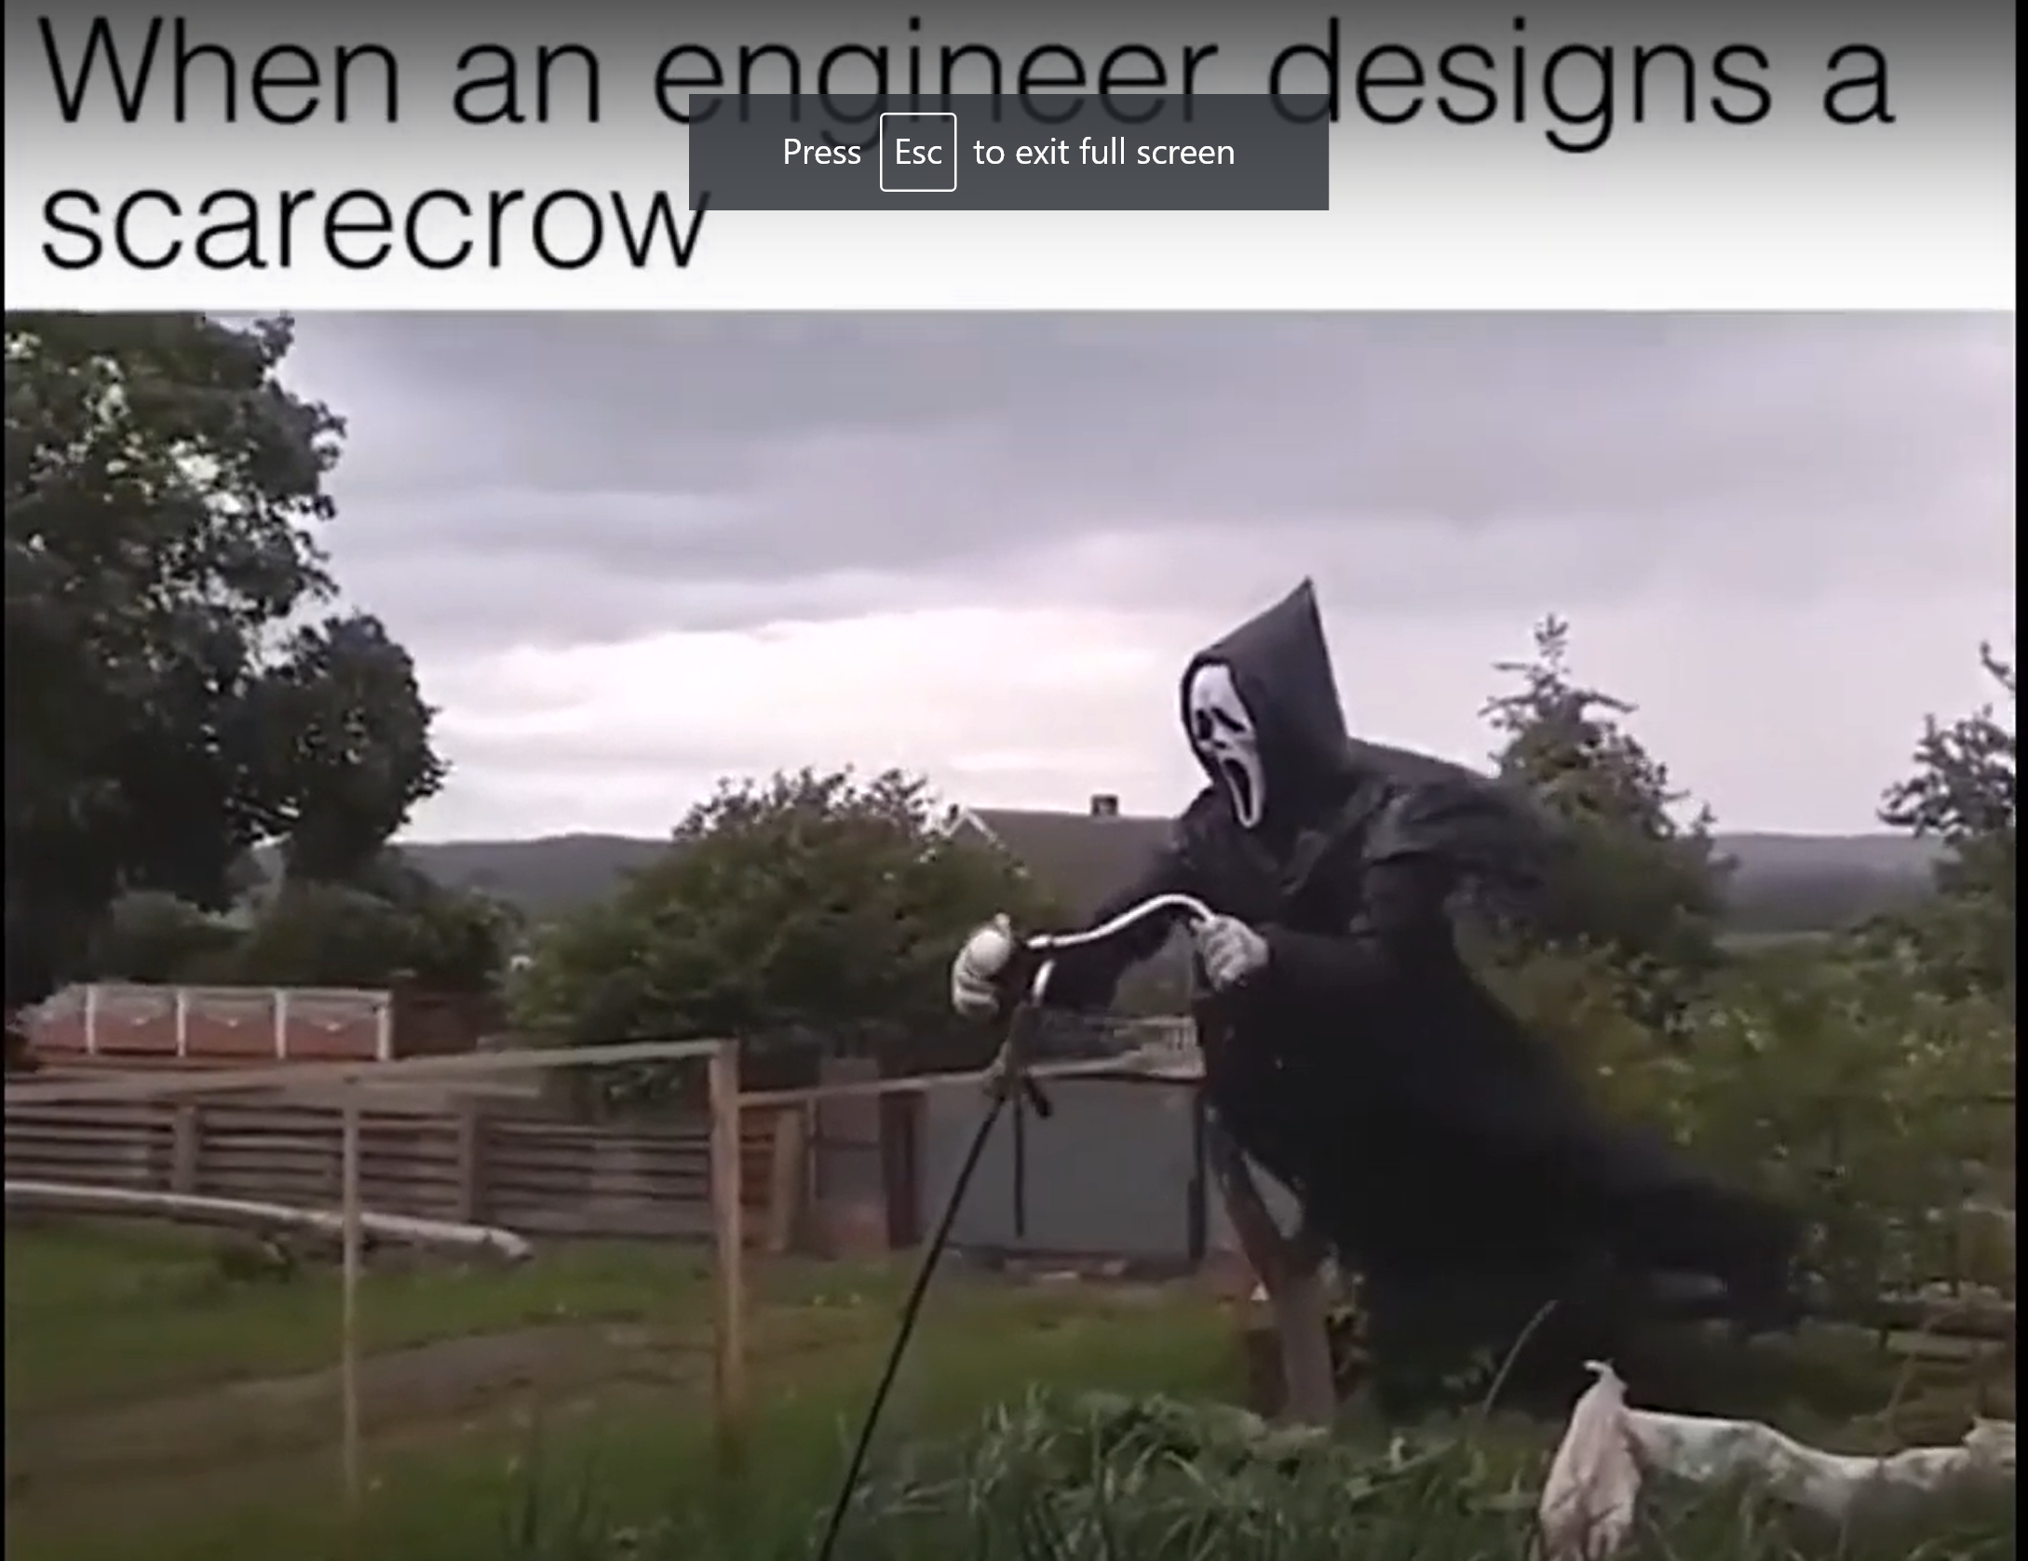
Stronger Winds can be fun . . . But are destructive
https://youtu.be/2HJcaNQnCJY

Slide 17
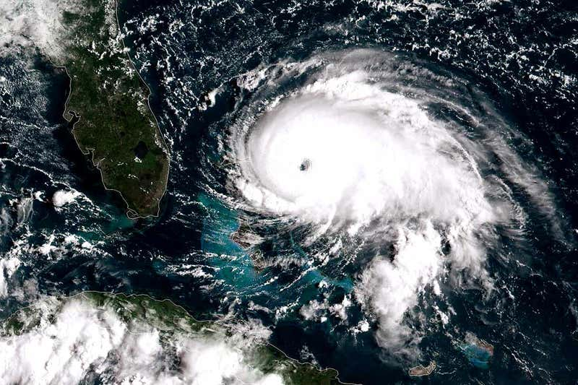
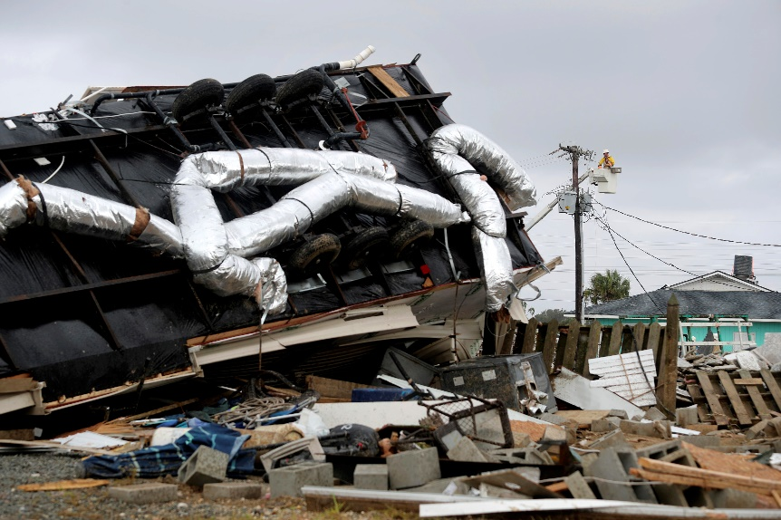
Stronger Winds - Hurricane Dorian

Slide 18
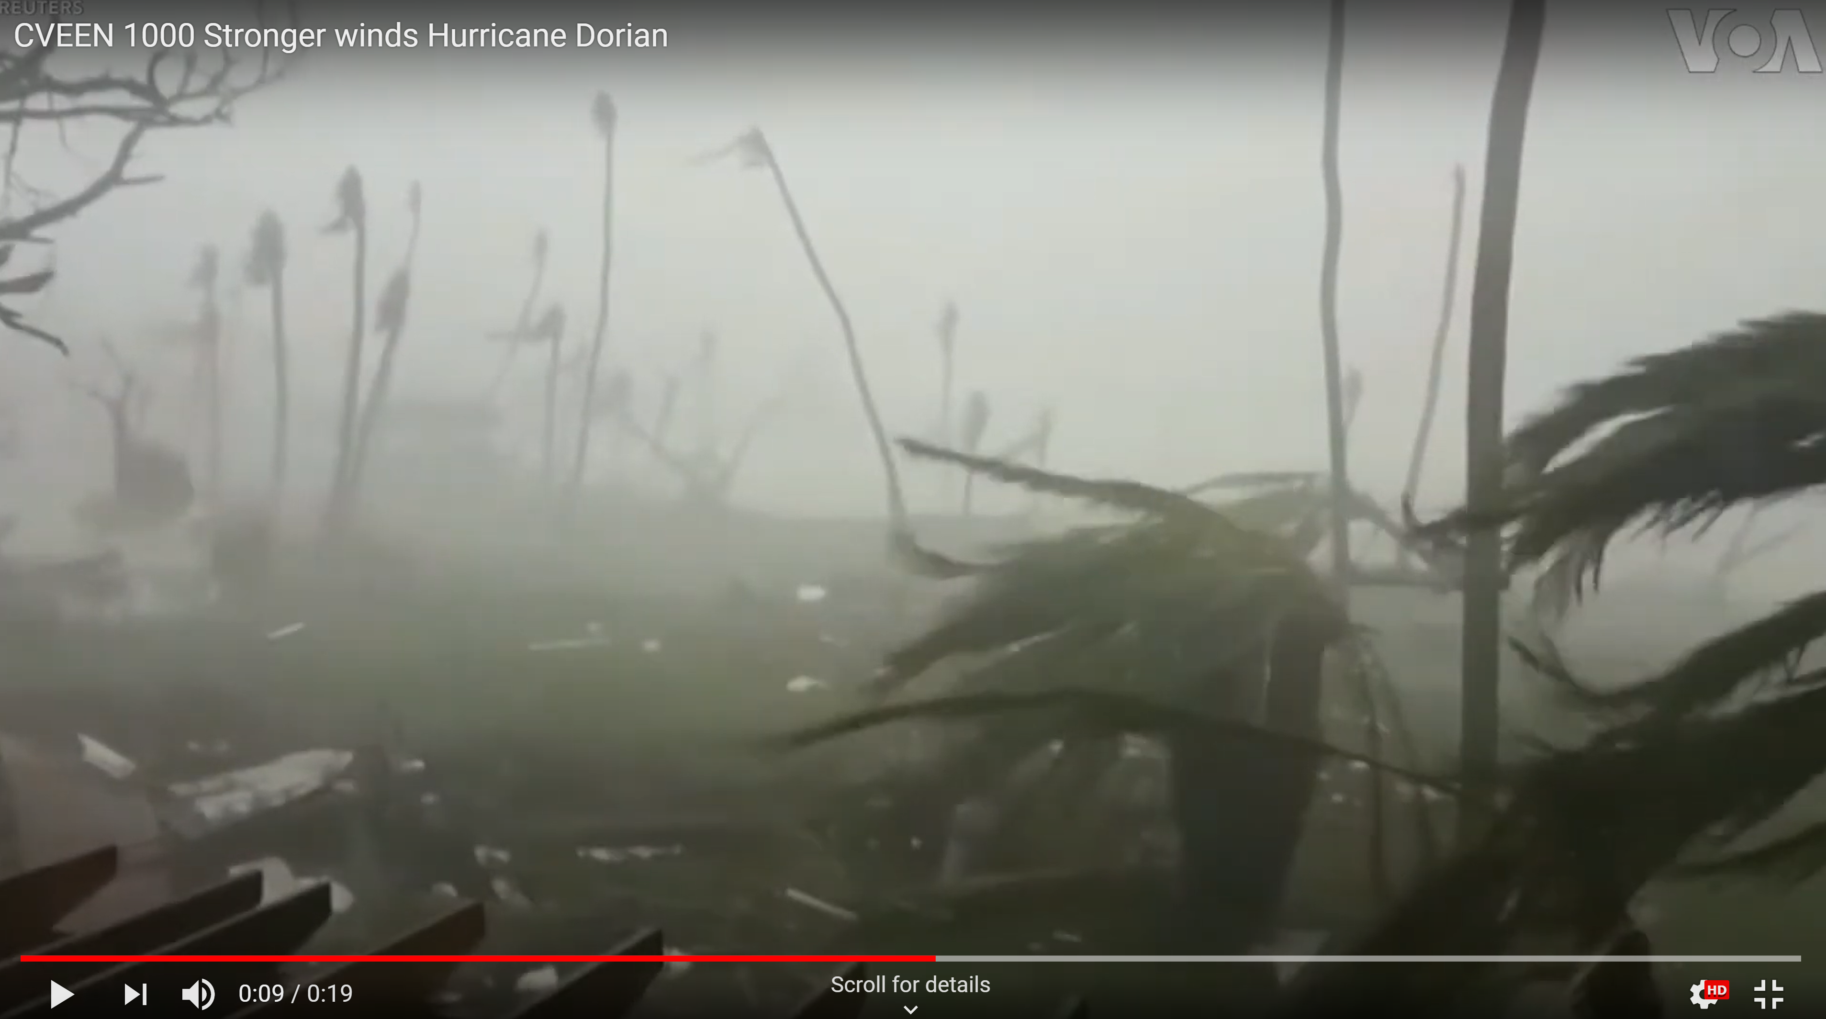
Stronger Winds - Hurricane Dorian
https://youtu.be/aF75ZKE6haM

Slide 19
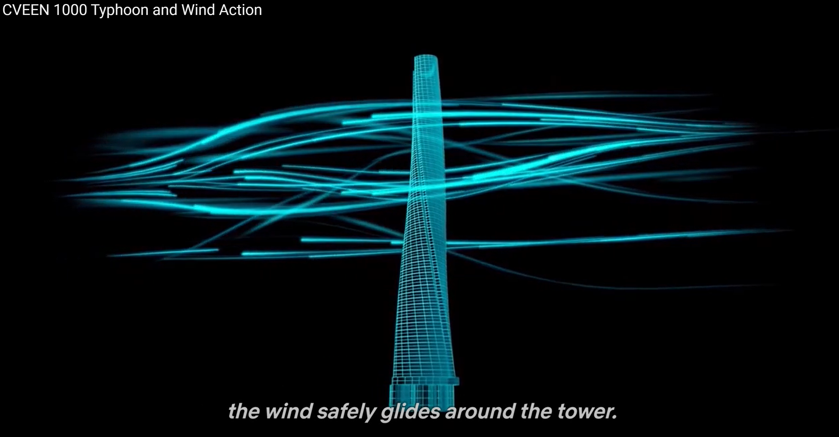
Typhoon and Wind Action
https://youtu.be/T7MfWAuU4dk

Slide 20
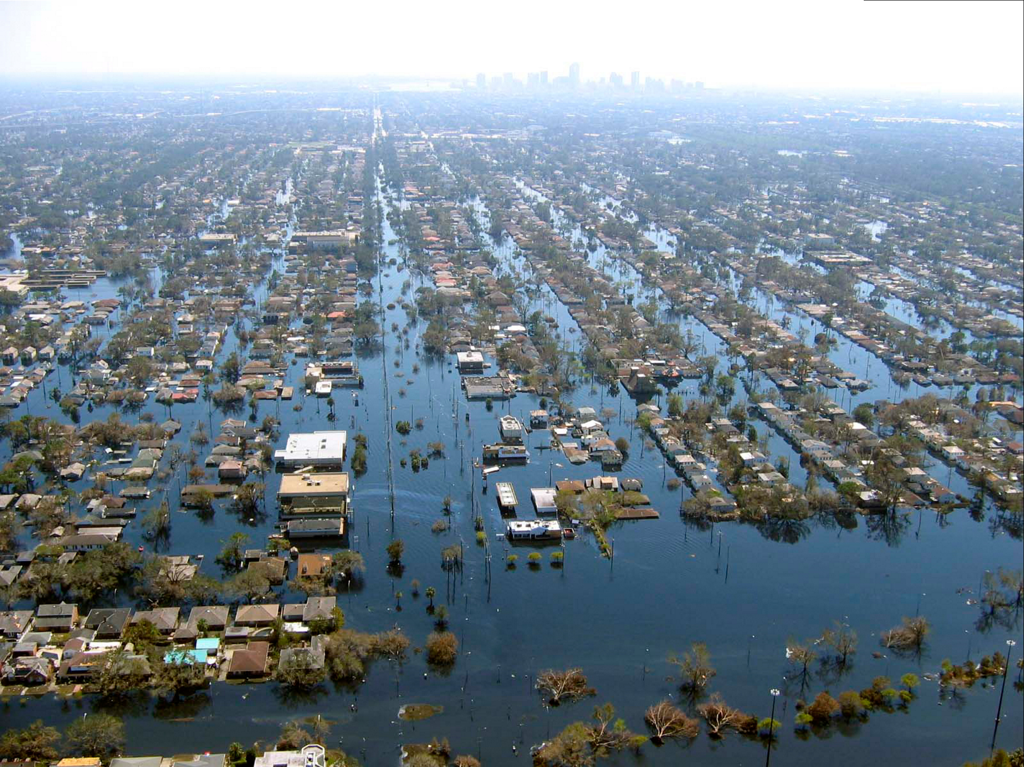
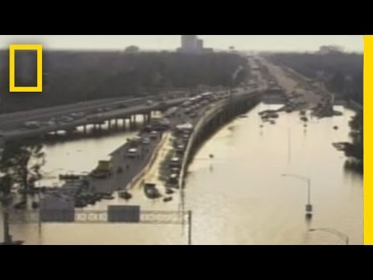
Flooding and Erosion
View of flooded New Orleans in
the aftermath of Hurricane Katrina
https://www.youtube.com/watch?v=7unlPvNxLLA

Slide 21
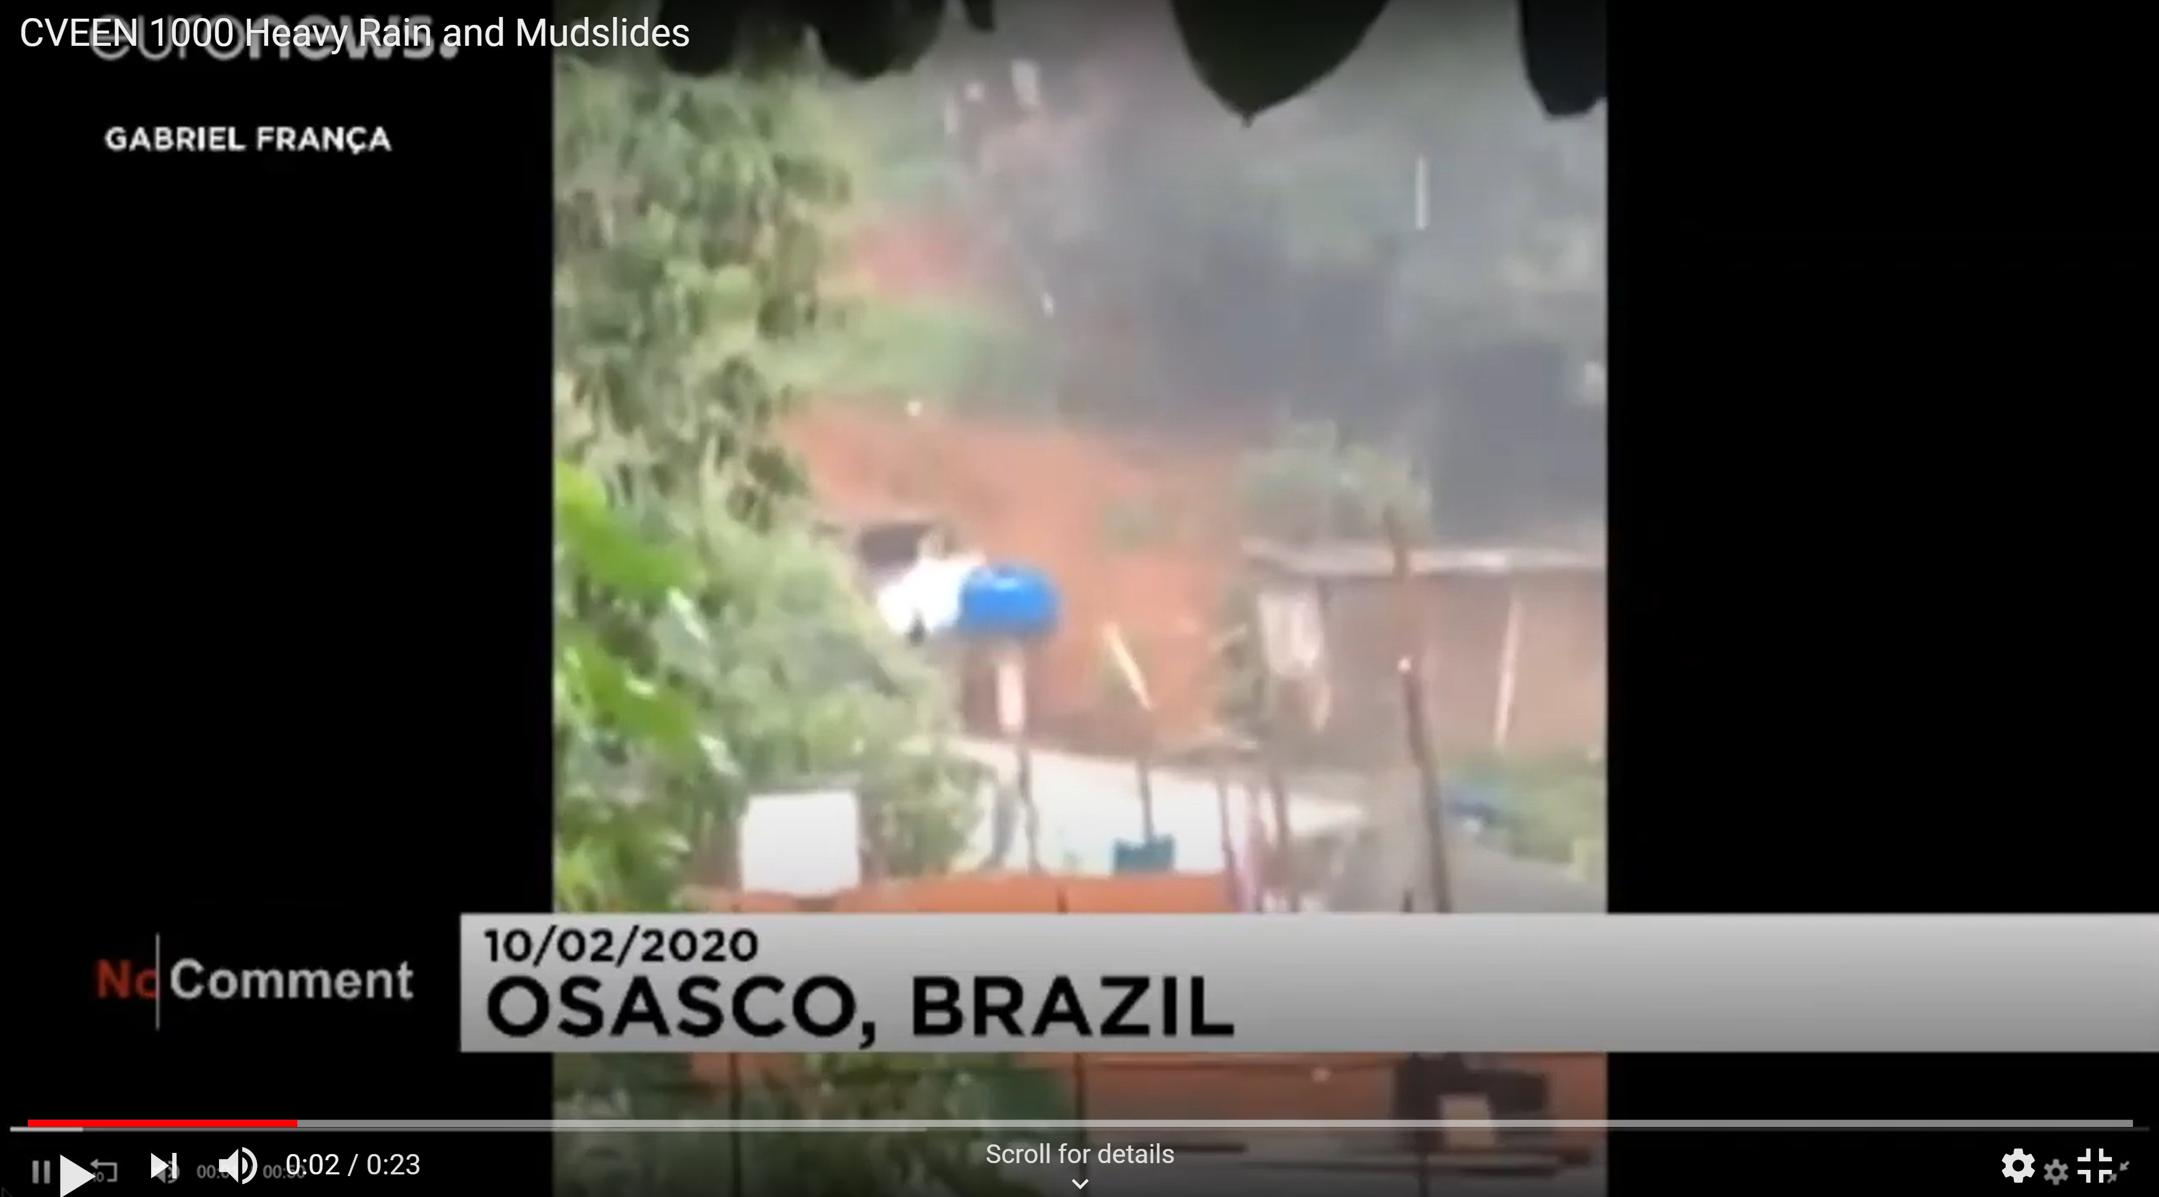
Heavy Rainfall & Mudslides
https://youtu.be/4DyqTN0LldI

Slide 22
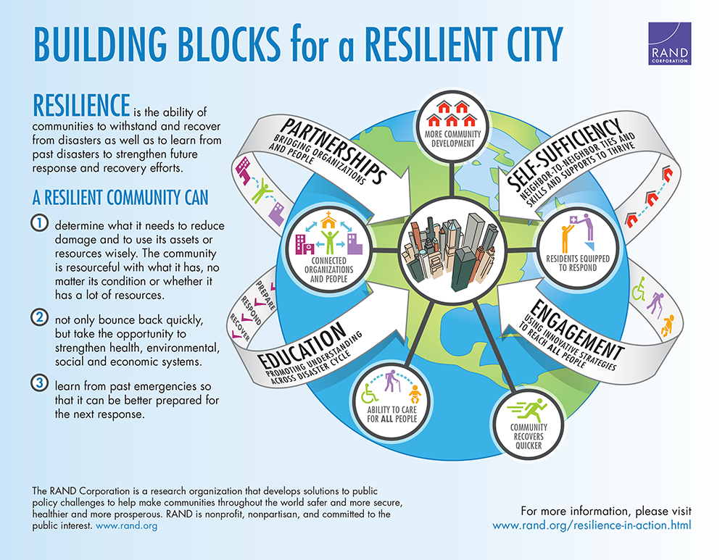
What can SOCIETY DUE TO slow climate change?
They must become more resilient!

Slide 23
The Engineering Four R’s of Resiliency
Robustness
Resilient
Systems
Resourcefulness
Redundancy
Rapidity

Slide 24
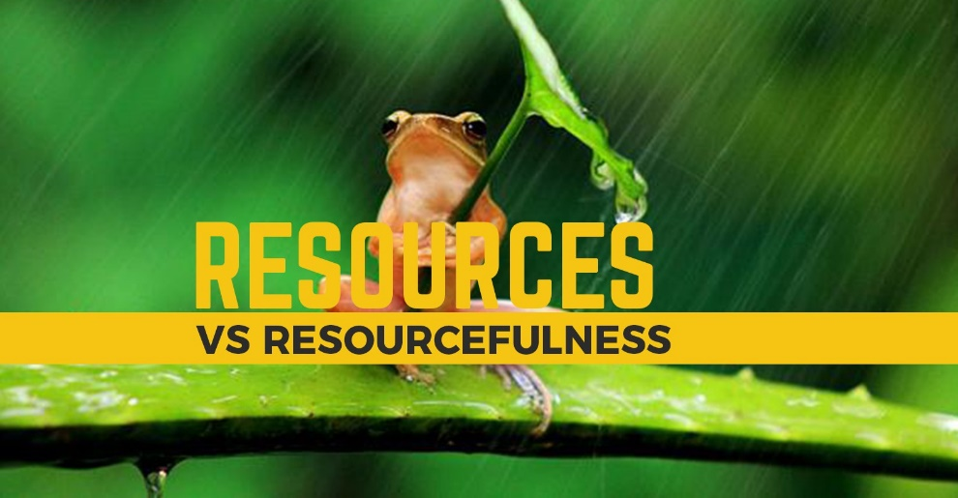
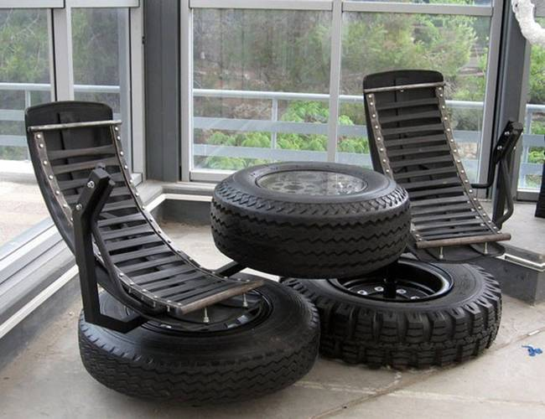
Resourcefulness
Making Do with What You Have
Making Alternative Functions

Slide 25
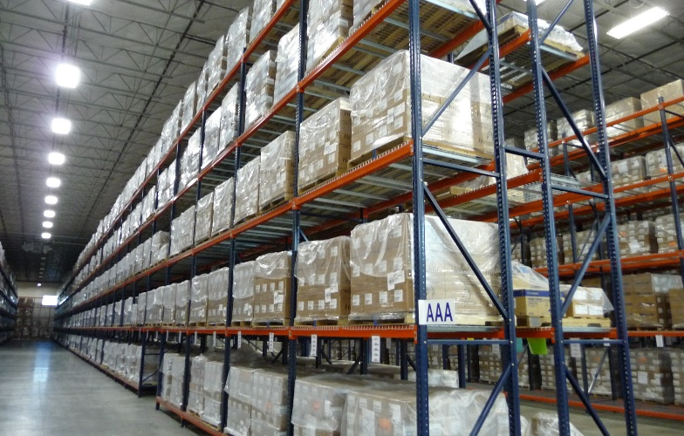
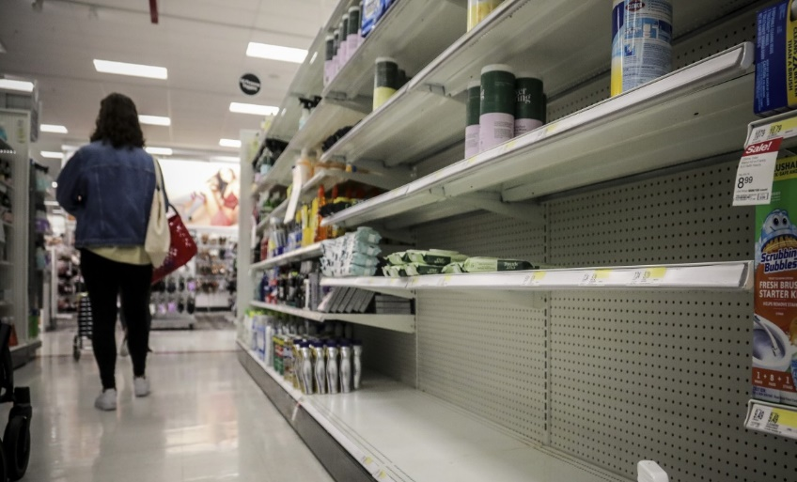
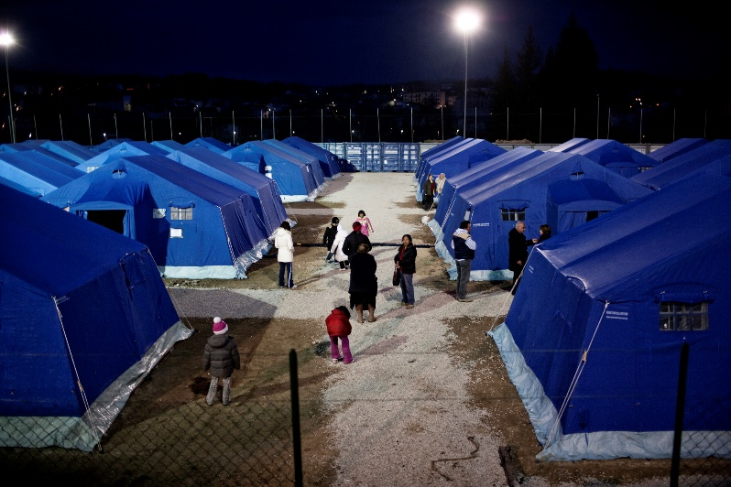
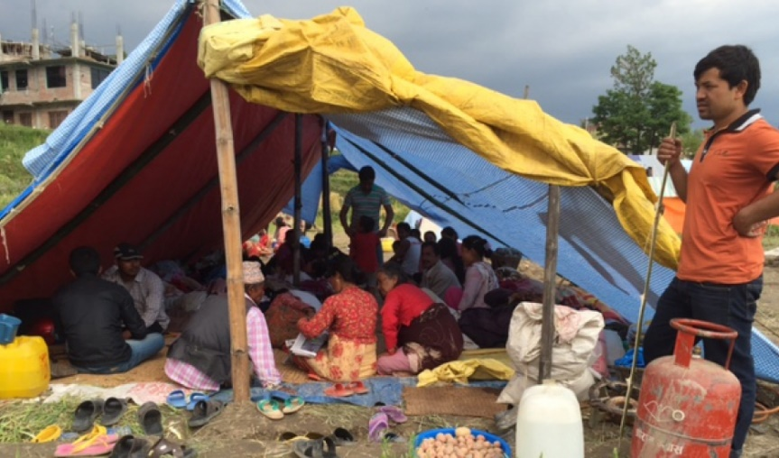
Resourcefulness
Having Resources
Lack of Resources

Slide 26
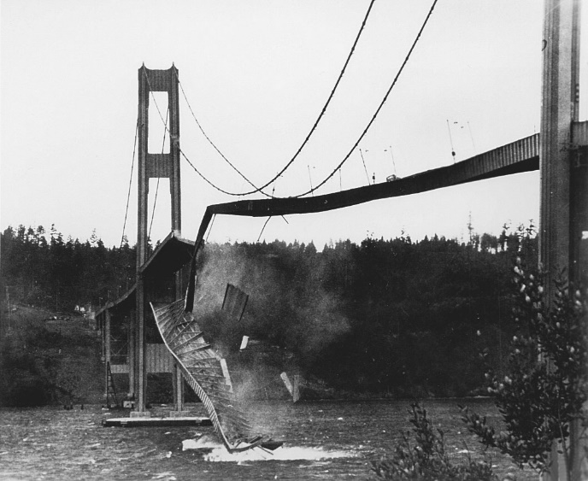
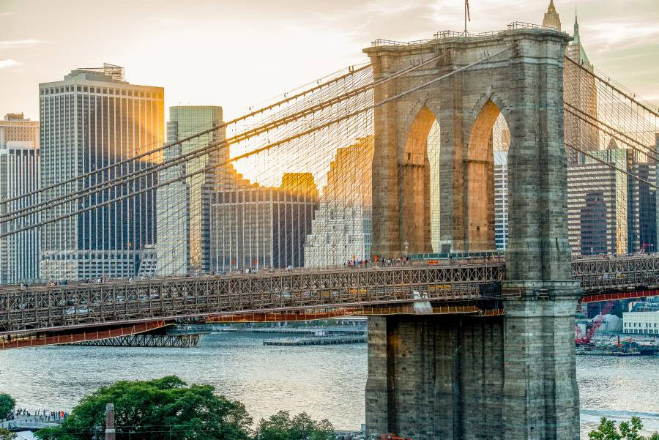
Robustness (Strength)
Fragile Robust
Tacoma Narrows Bridge,
Washington
Brooklyn Bridge, New York

Slide 27
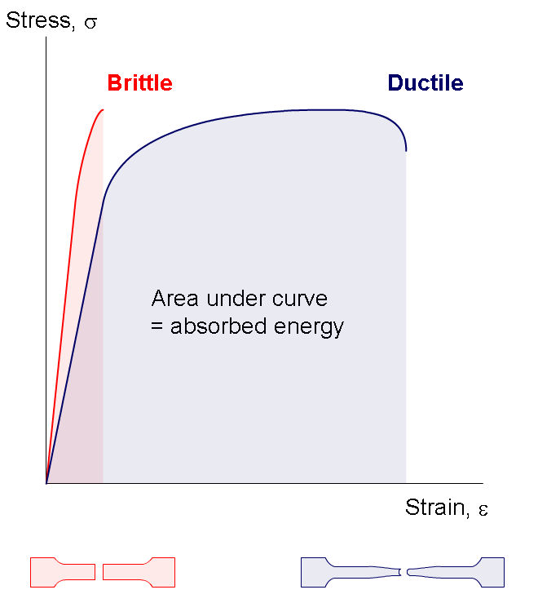
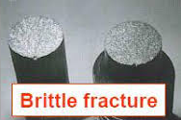
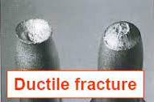
Robustness (Ductile)
Brittle Flexible

Slide 28
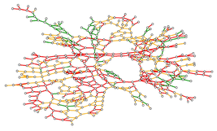
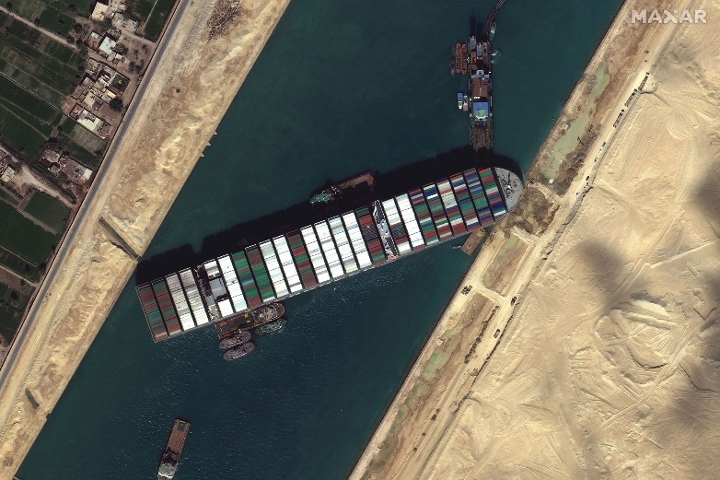
Redundancy
B
A
Traffic Network with Redundancy
Maritime Network with Choke Point

Slide 29
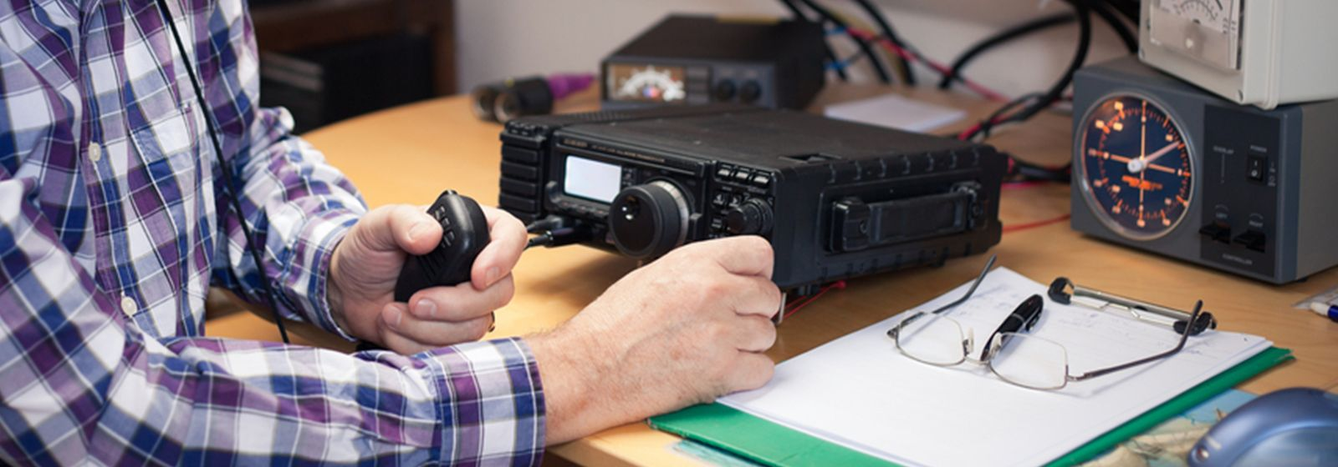
Redundancy
Cell Phone Network (non-functional)
Ham Radio Communication (functional)

Slide 30
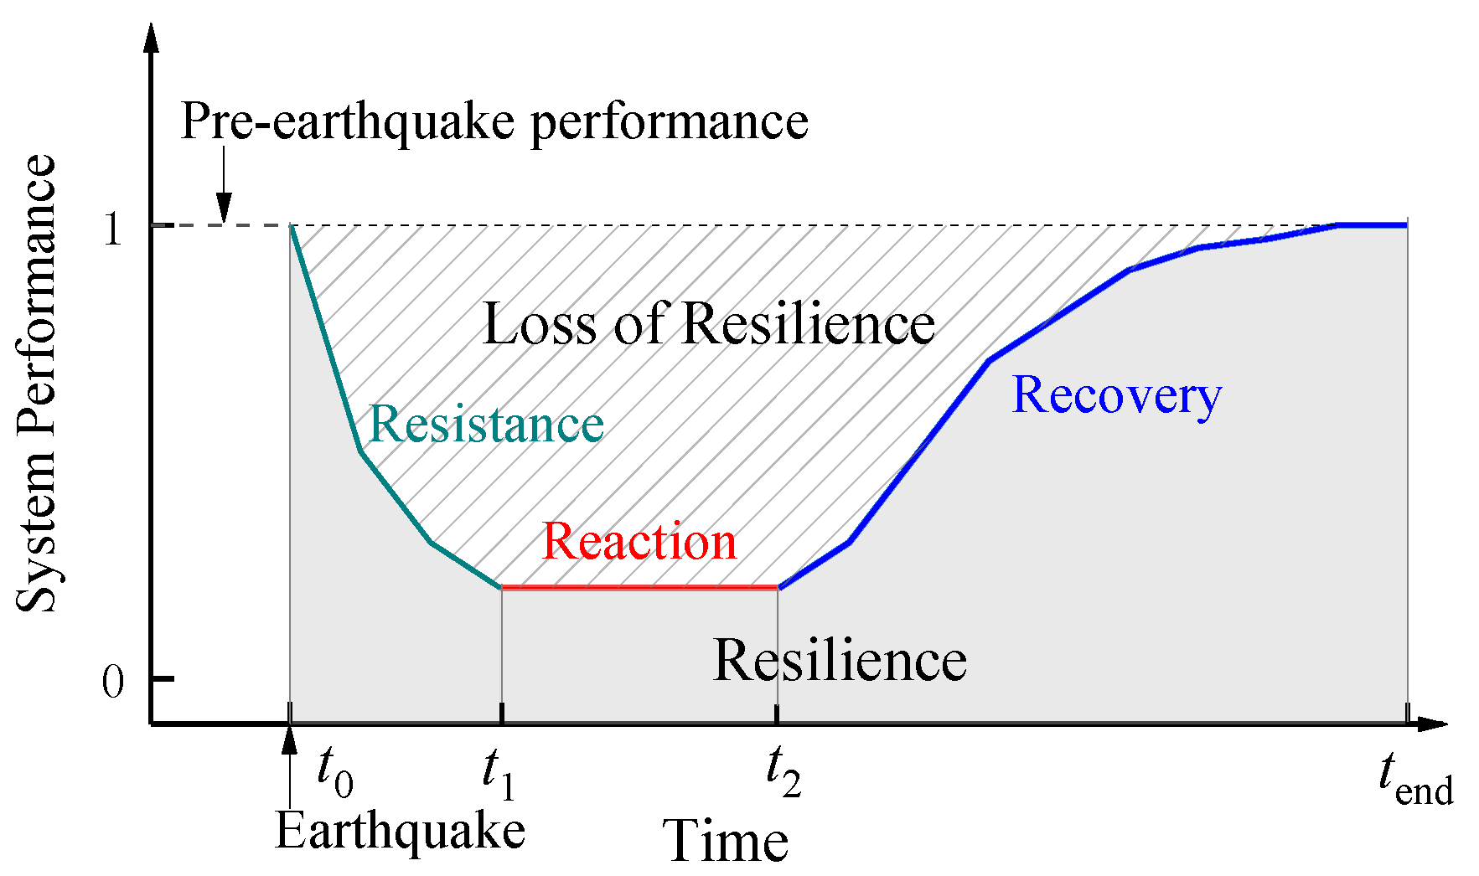
Rapidity

Slide 31
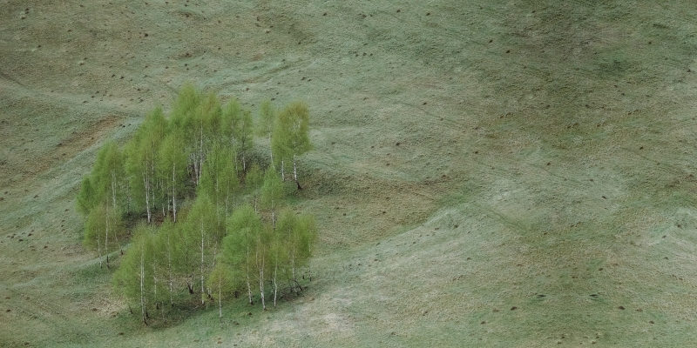
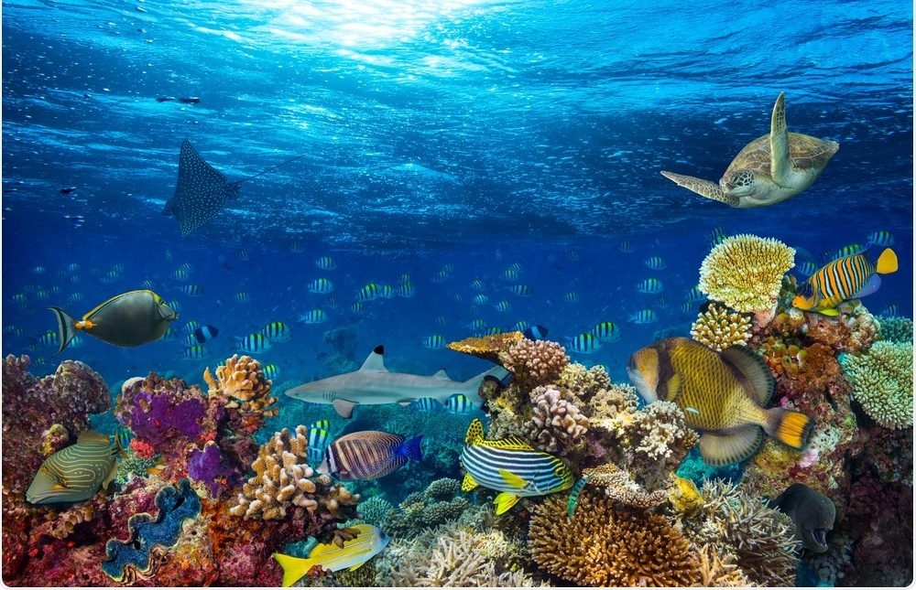
What can SOCIETY DUE TO slow climate change?
Protect and Restore
Ecosystems
https://aida-americas.org/en/blog/5-ways-our-governments-can-confront-climate-change

Slide 32
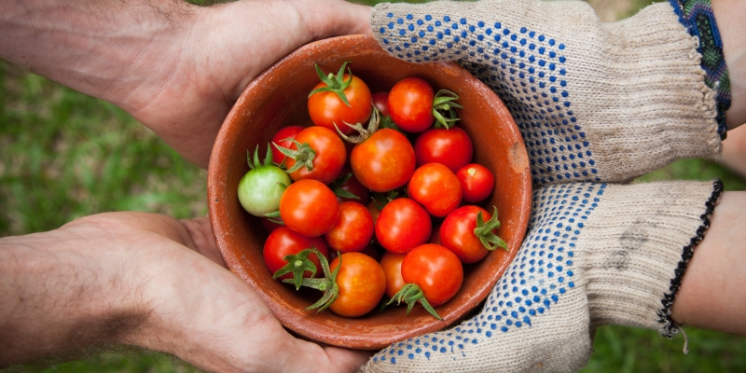
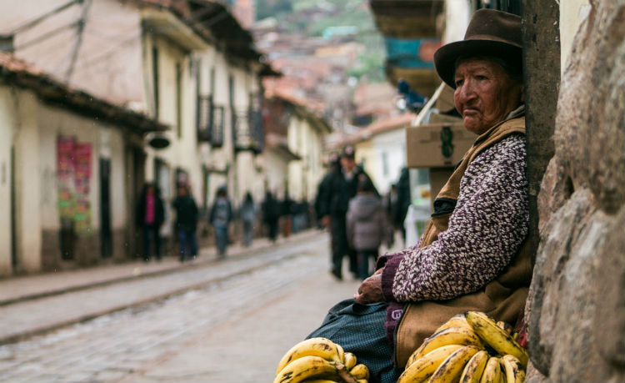
What can SOCIETY DUE TO slow climate change?
Support Small Agricultural
Producers
https://aida-americas.org/en/blog/5-ways-our-governments-can-confront-climate-change

Slide 33
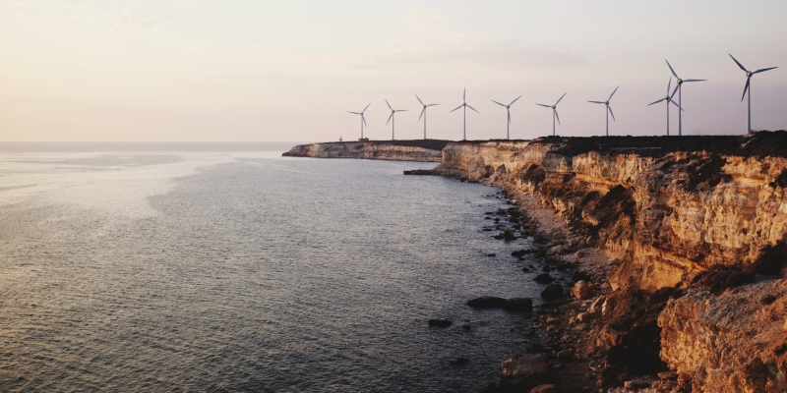
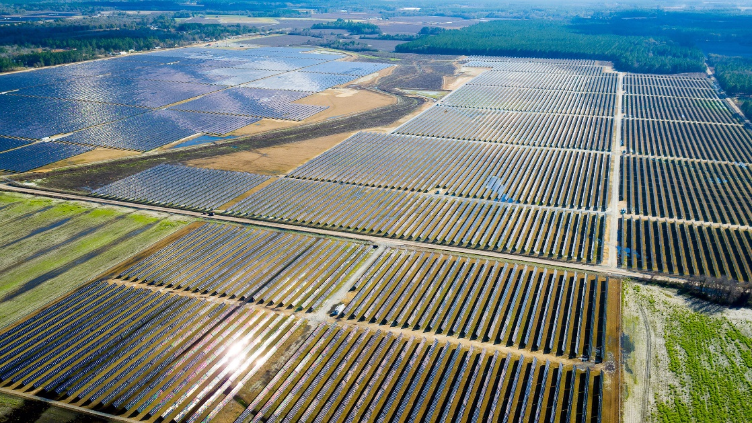
What can SOCIETY DUE TO slow climate change?
Promote Green Energy
https://aida-americas.org/en/blog/5-ways-our-governments-can-confront-climate-change

Slide 34
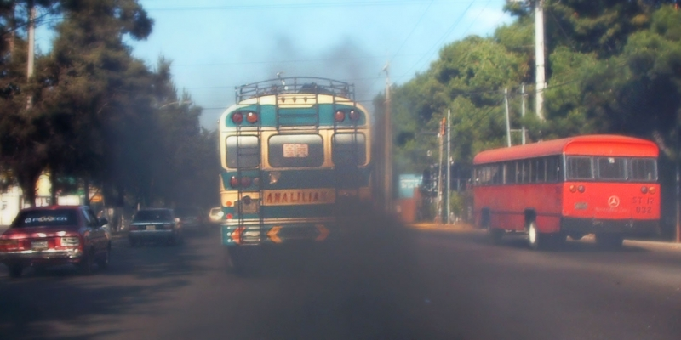
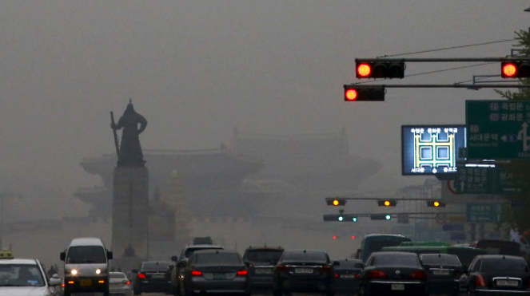
What can SOCIETY DUE TO slow climate change?
Combat Shot-lived Climate Pollutants
https://aida-americas.org/en/blog/5-ways-our-governments-can-confront-climate-change

Slide 35
What can SOCIETY DUE TO slow climate change?
https://portals.iucn.org/library/sites/library/files/documents/PAG-024.pdf
BET ON ADAPTATION, NOT JUST MITIGATION
https://aida-americas.org/en/blog/5-ways-our-governments-can-confront-climate-change

Slide 36
What can I do as an INDIVIDUAL to slow climate change?
Speak up!
Power your home with renewable energy.
Weatherize, weatherize, weatherize.
Invest in energy-efficient appliances.
Reduce water waste.
Actually eat the food you buy—and make less of it meat.
Buy better bulbs.
Pull the plug(s).
Drive a fuel-efficient vehicle.
Maintain your ride.
Rethink planes, trains, and automobiles.
Shrink your carbon profile.
https://www.nrdc.org/stories/how-you-can-stop-global-warming

Slide 37
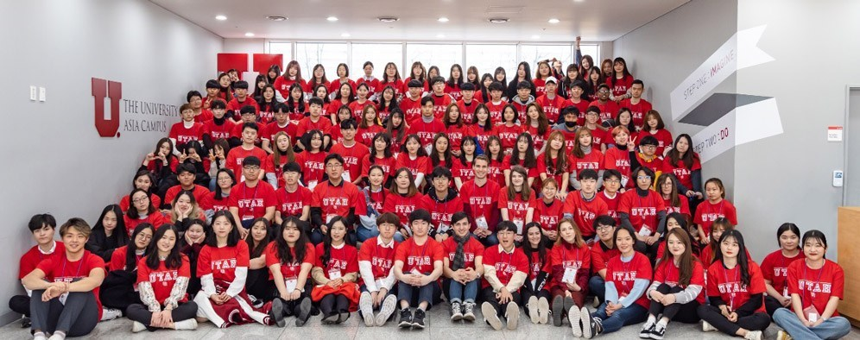
Thank You!!
https://www.civil.utah.edu/

