Slide 1
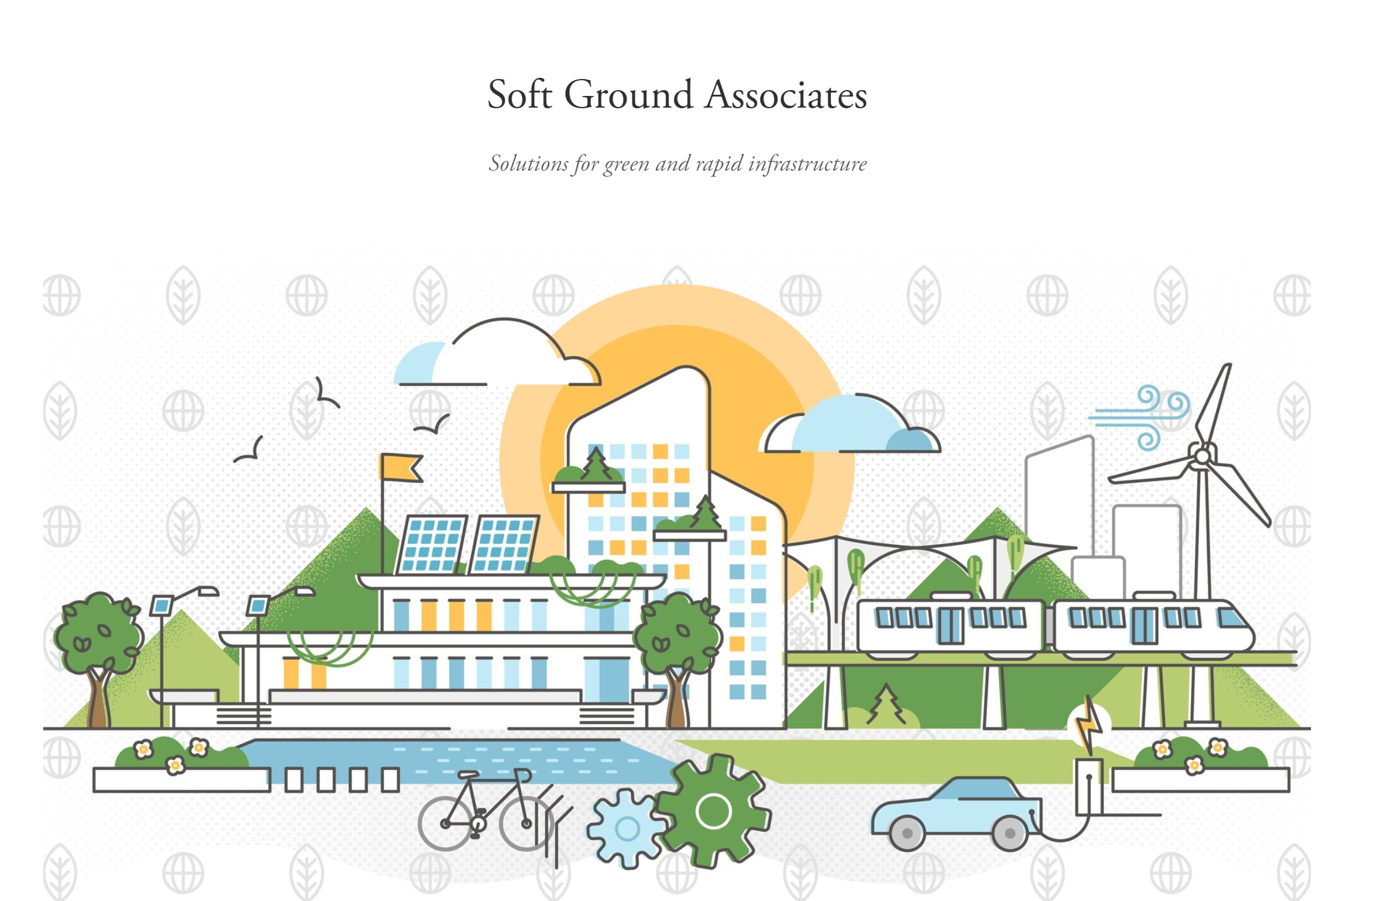


Geofoam applications present and future
Steven F. Bartlett, Ph.D., P.E.
https://www.sfb-engineering.com/

Slide 2

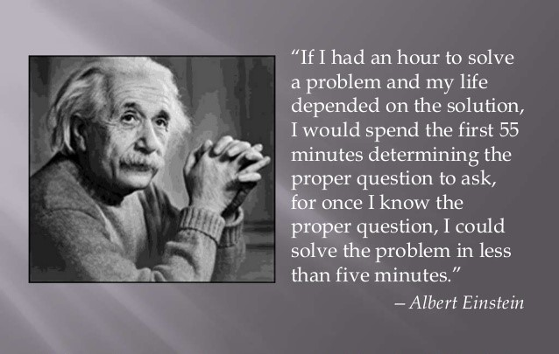
Imaginative, Critical Thought

Slide 3

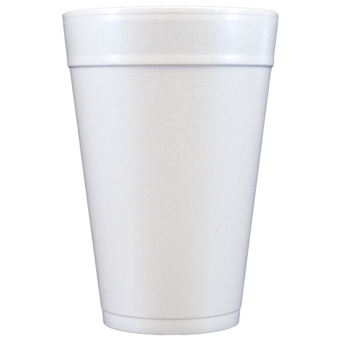
Expressways on Styrofoam?

Slide 4
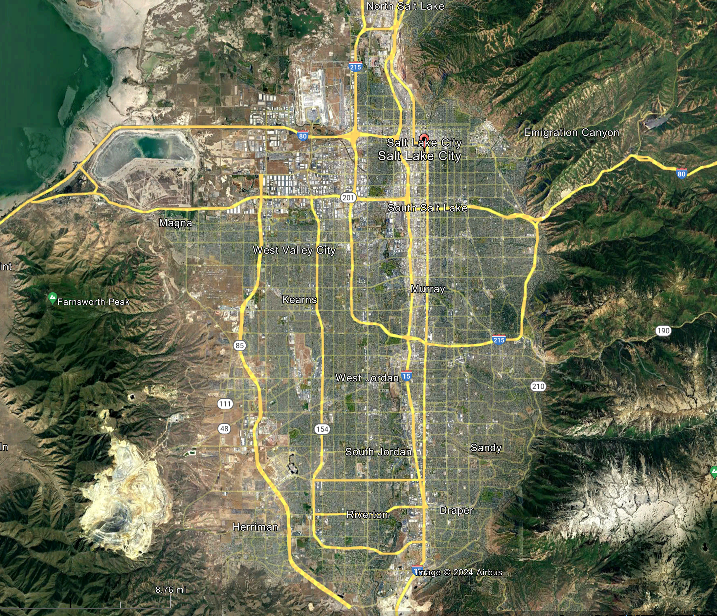

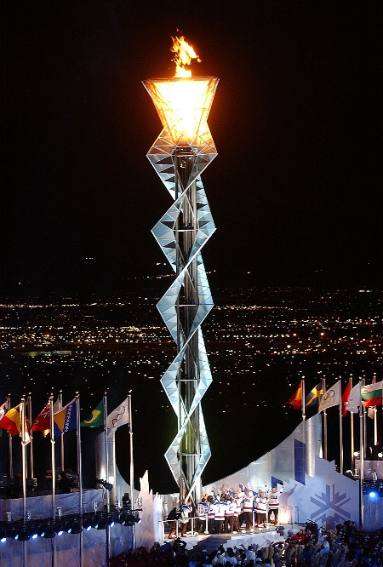

I-15 Project – Salt valley

Slide 5
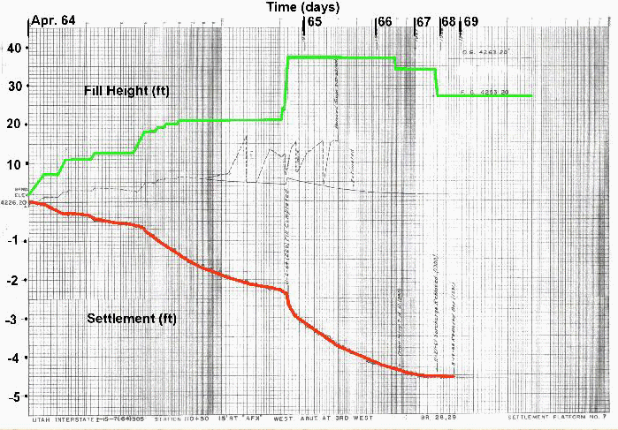
I-15 Project – Settlement Record 1960s
2.5 year duration
Primary Settlement

Slide 6
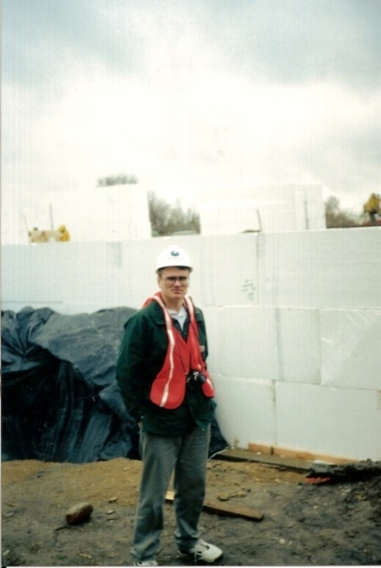
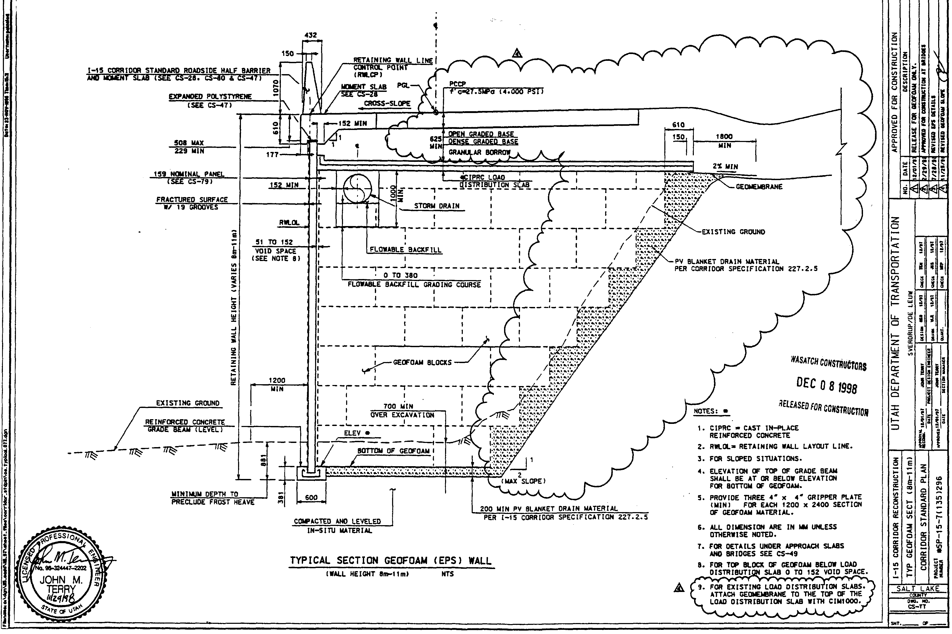
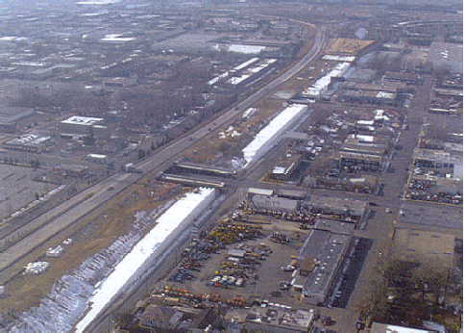
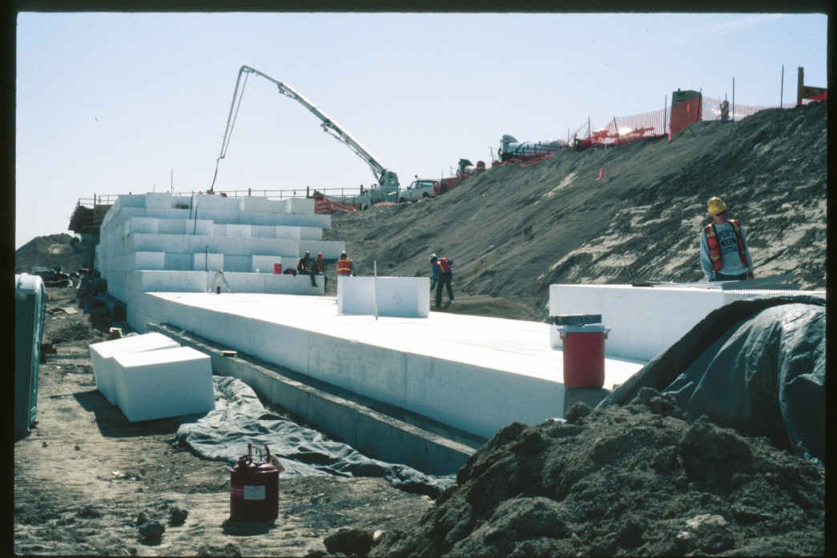
I-15 Reconstruction Geofoam Task Force Team

Slide 7
Advantages of Light-weight materials
Properties
Light-weight to ultra light-weight
High strength to mass ratio
Good damping characteristics
Thermal Insulators
High Buoyancy
Important Functions
Reduces soil settlement
Improves bearing capacity of roadways
Improves foundation, wall and slope stability
Decreases horizontal and vertical loads
Rapid construction
Can save construction time and money

Slide 8
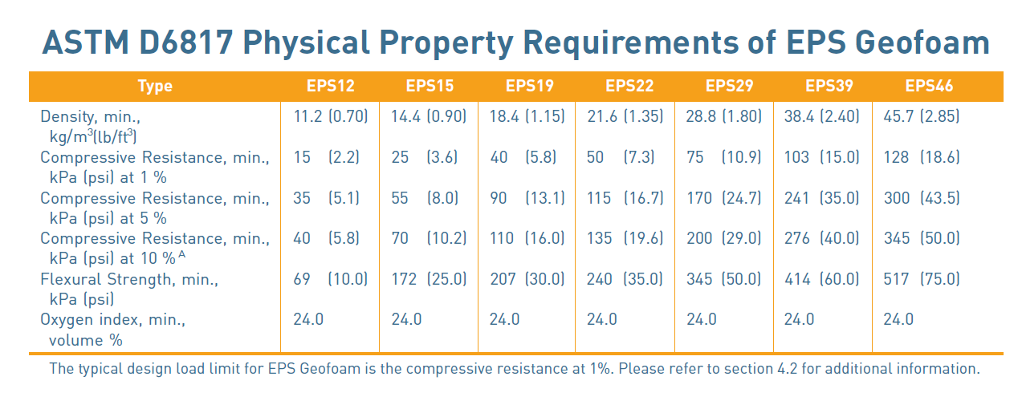
ASTM D6817

Slide 9
STRENGTH AND COMPRESSIVE RESISTANCE
Design Value (combination of dead and live loads)

Slide 10
Primary Applications of EPS Geofoam
Landscaping and green roofs
Lightweight fill for retaining and buried walls
Culverts, pipelines, utilities
Stadium and theater seating
Airport runway and taxiways
Roadway construction
Rail embankment
Bridge abutments
Bridge underfill
Accelerated bridge construction
Compensating foundations
Slope stabilization
Retaining and buried wall backfill
Raising of Leeves and Dikes
Foundation for lightweight structures

Slide 11
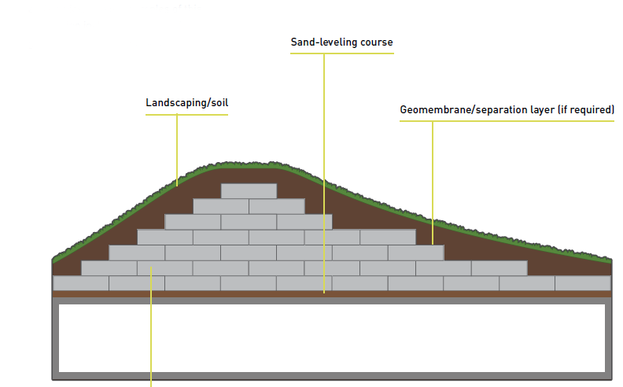
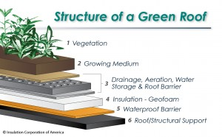
Landscapiing and green roofs

Slide 12

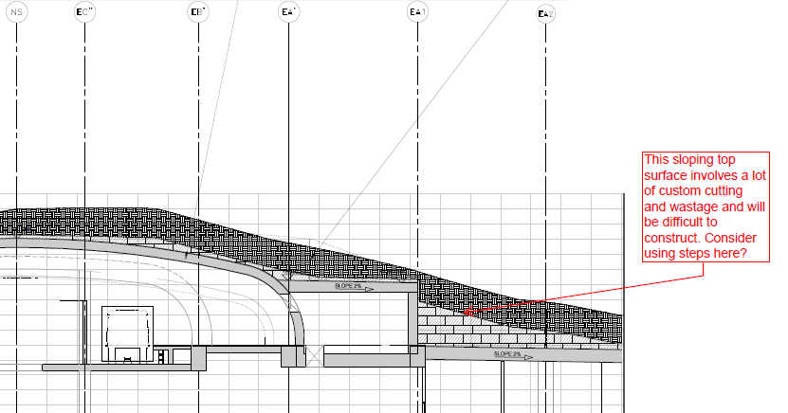

Landscaping and green roofs
Lessons
Combine green roof with EPS insulation to achieve better energy performance
Angular concrete surfaces and hardscape can be sculpted to create better aesthetics.
Airport Terminal – Jeddah

Slide 13

spaceships that never fly?

Slide 14
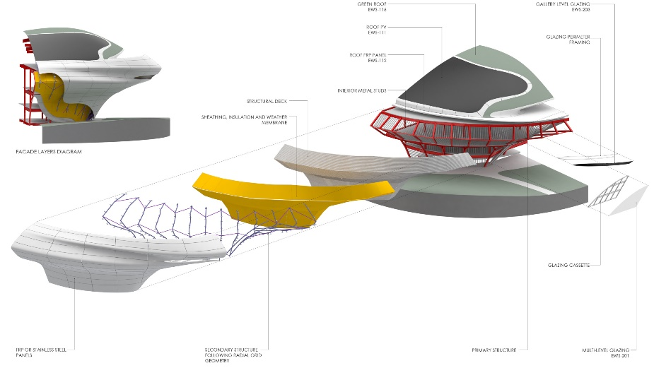



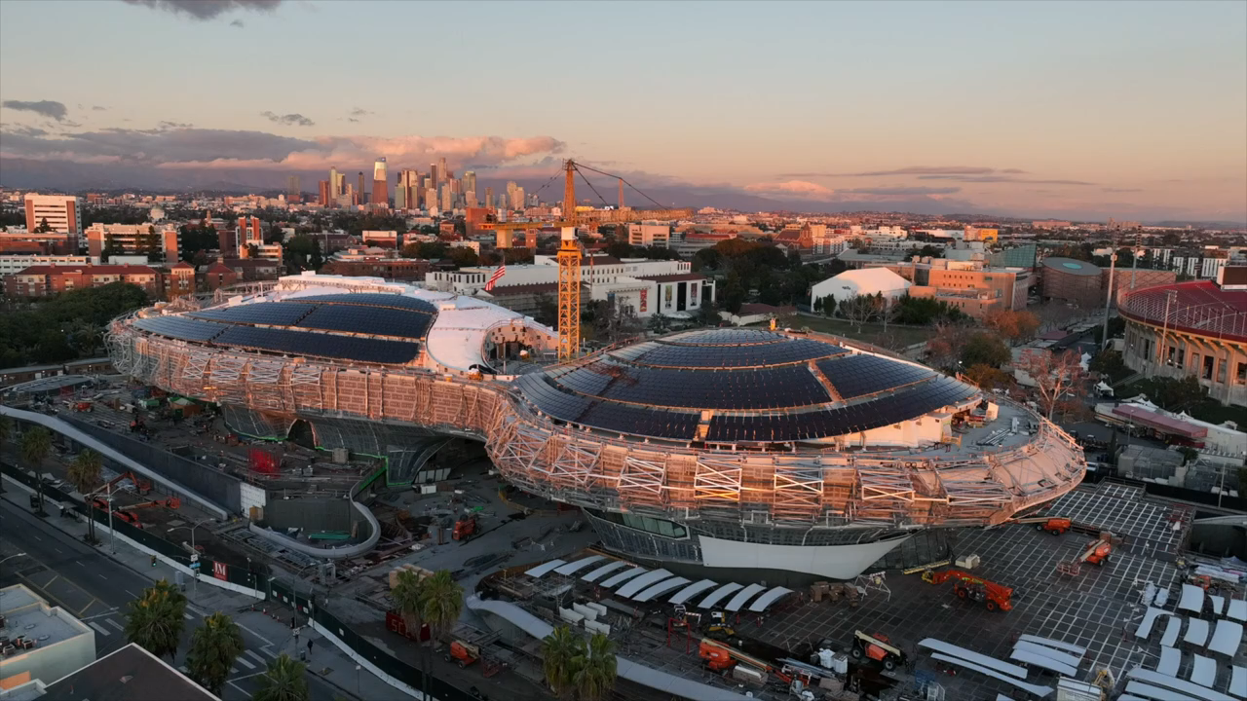


Landscaping and green roofs
Lucas Museum –– Los Angeles
Hover to to Play

Slide 15
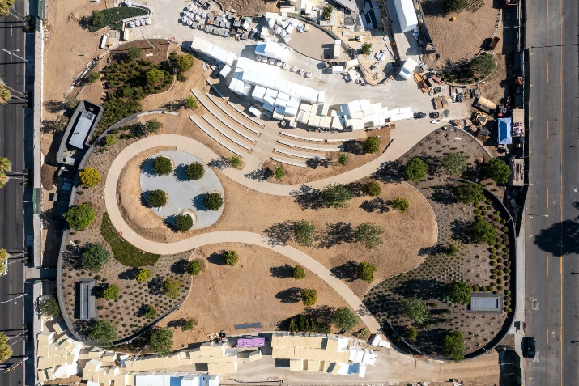
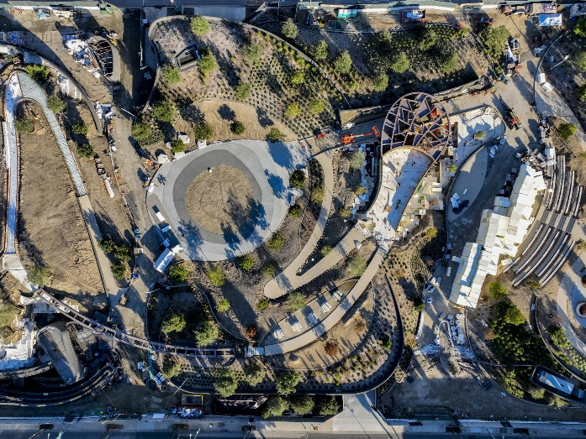
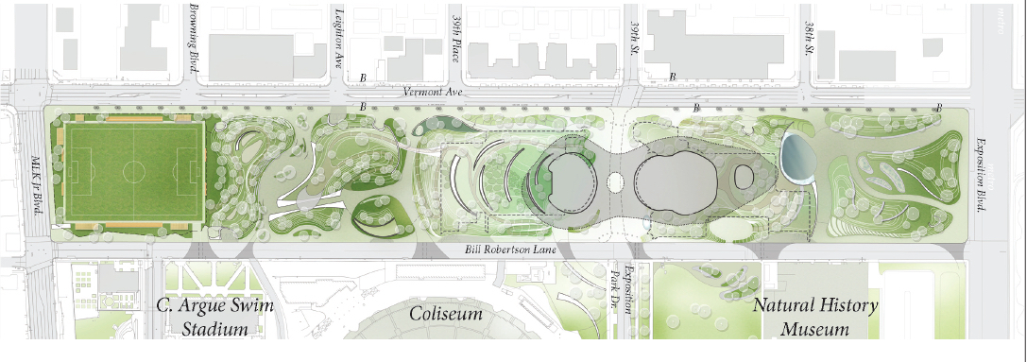
Landscaping and green roofs
Lessons
Complex project can require further testing and design revisions to satisfy permitting agencies
Design of green roofs can be complex in high seismic regions.
South Park
South Park – Mirror Water Feature
Los Angeles Dept. of City Planning

Slide 16


Ice Cream Castles IN The SKY?

Slide 17
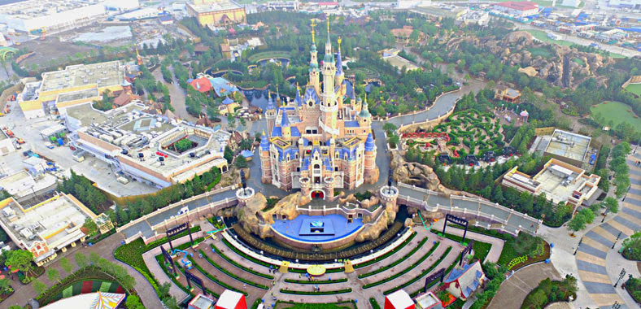

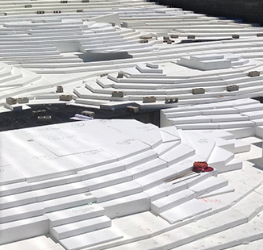

Landscaping and green roofs
Mission Rock Development, San Francisco, CA

Slide 18
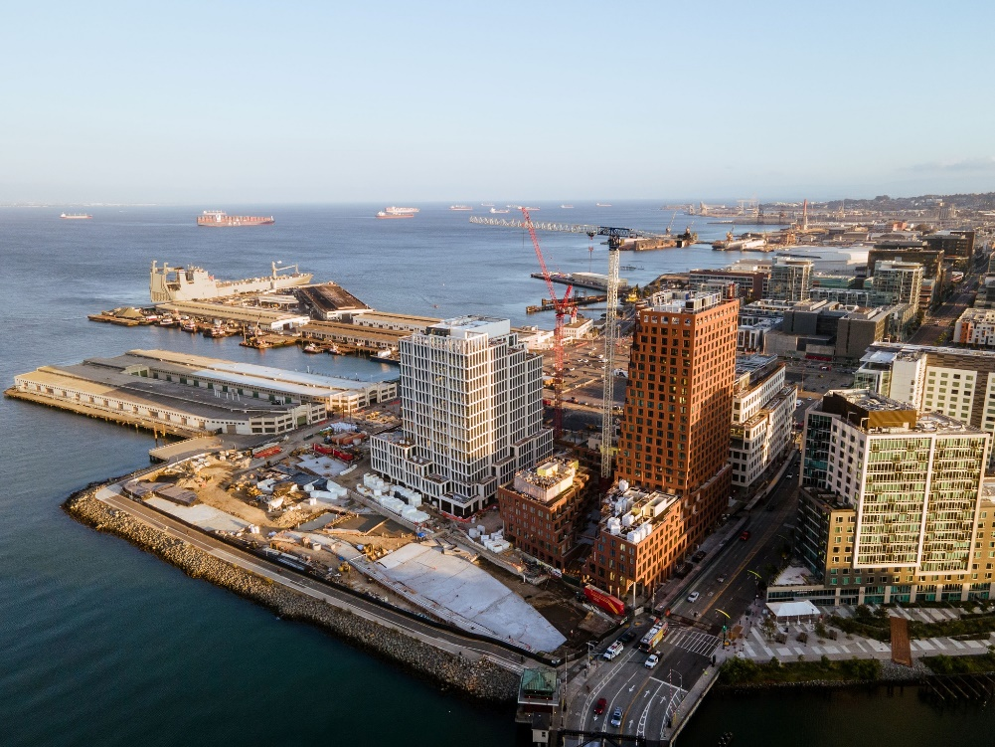






Coastal engineering & Ground Reclamation
Mission Rock Development, San Francisco, CA
China Bay
(geofoam placement area)

Slide 19
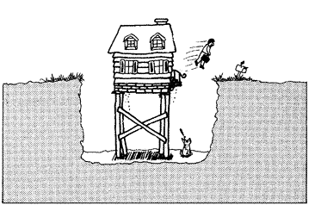

houses with flying men?

Slide 20
Retaining & wall backfill
Reduction of Earth Pressures Against Structures
(EPS Geofoam Applications & Technical Data by EPSIA, 2012)

Slide 21
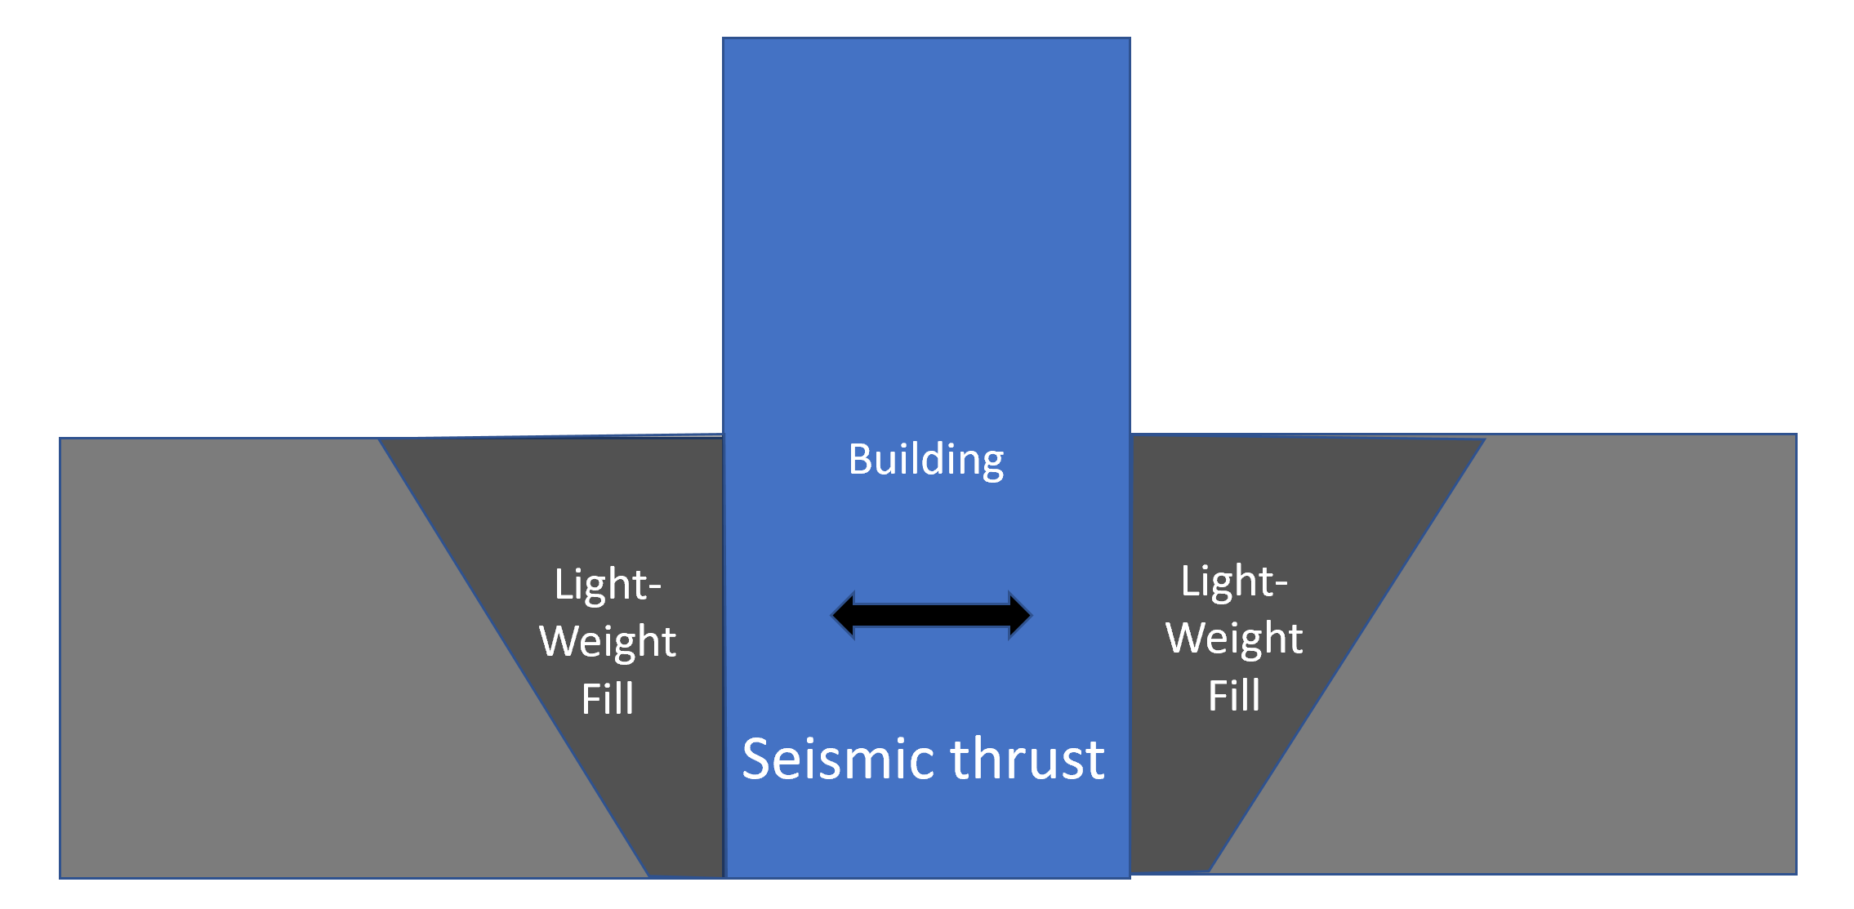
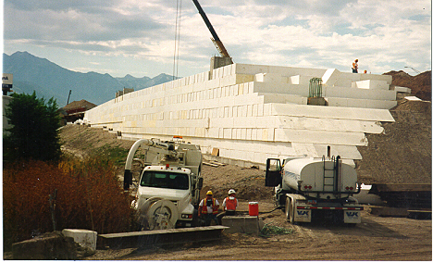
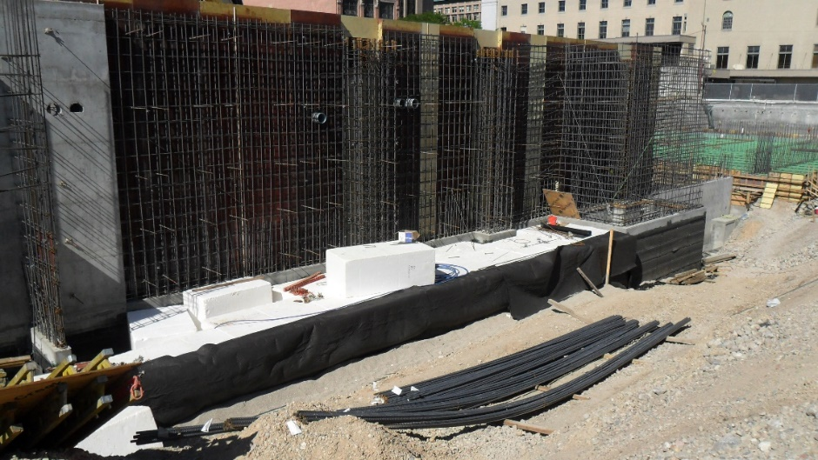
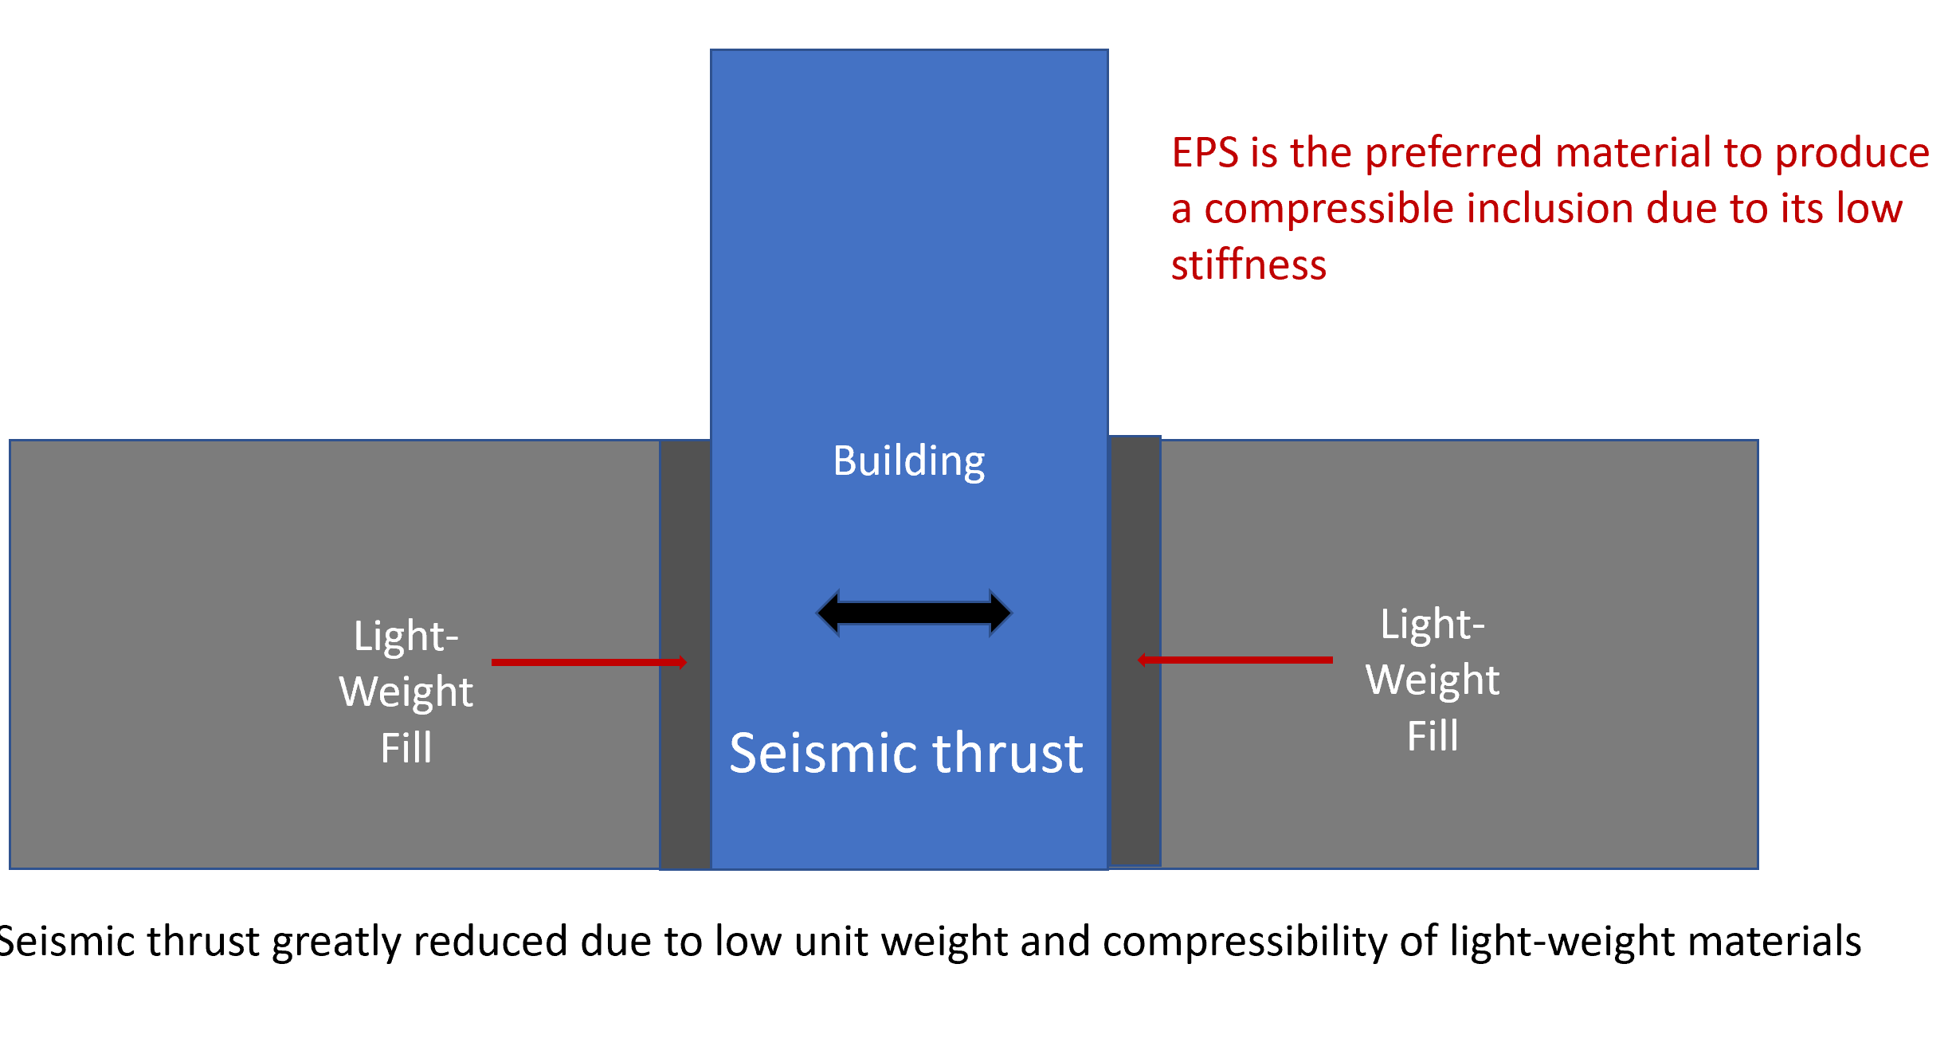
Retaining & wall backfill
Reduction of Earth Pressures Against Structures

Slide 22

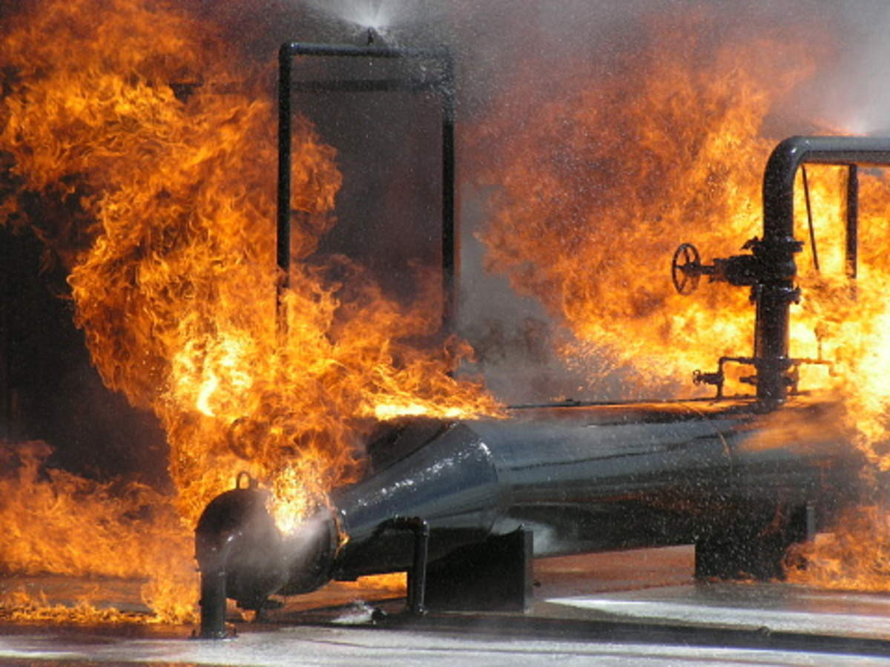

Utilities that never break?

Slide 23
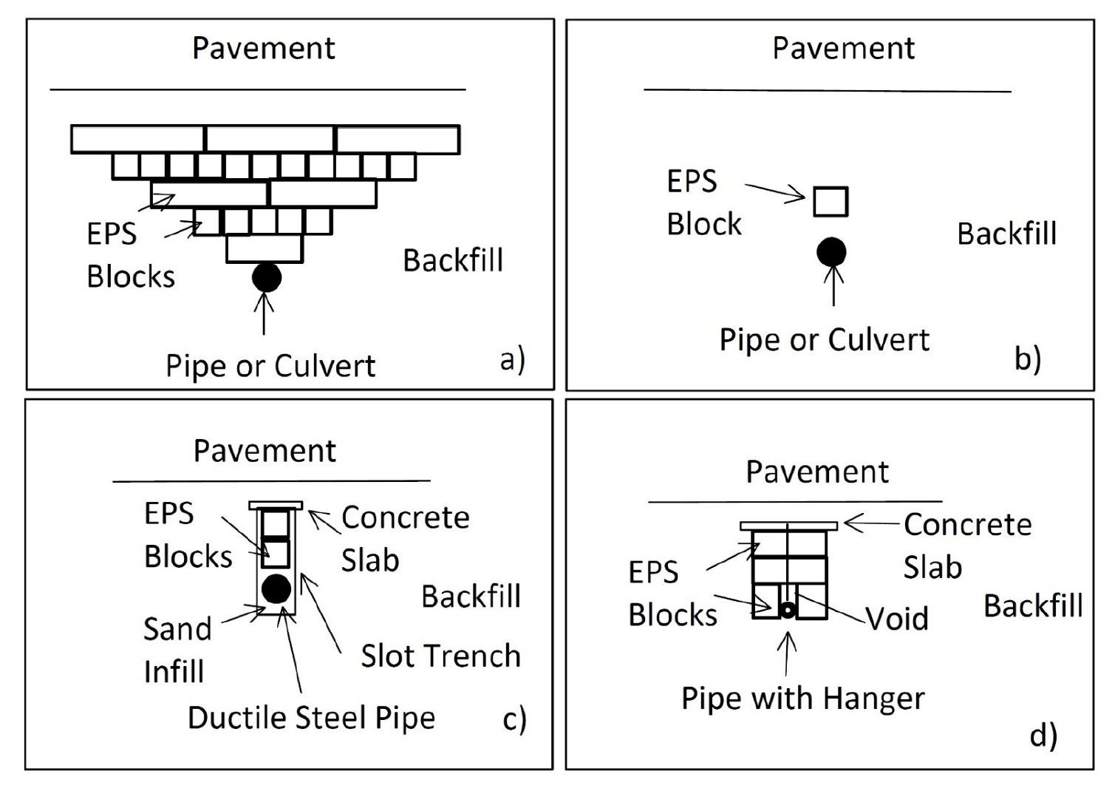
Reduction of load on Utilities and Pipelines

Slide 24
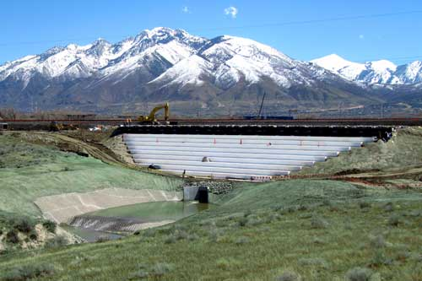
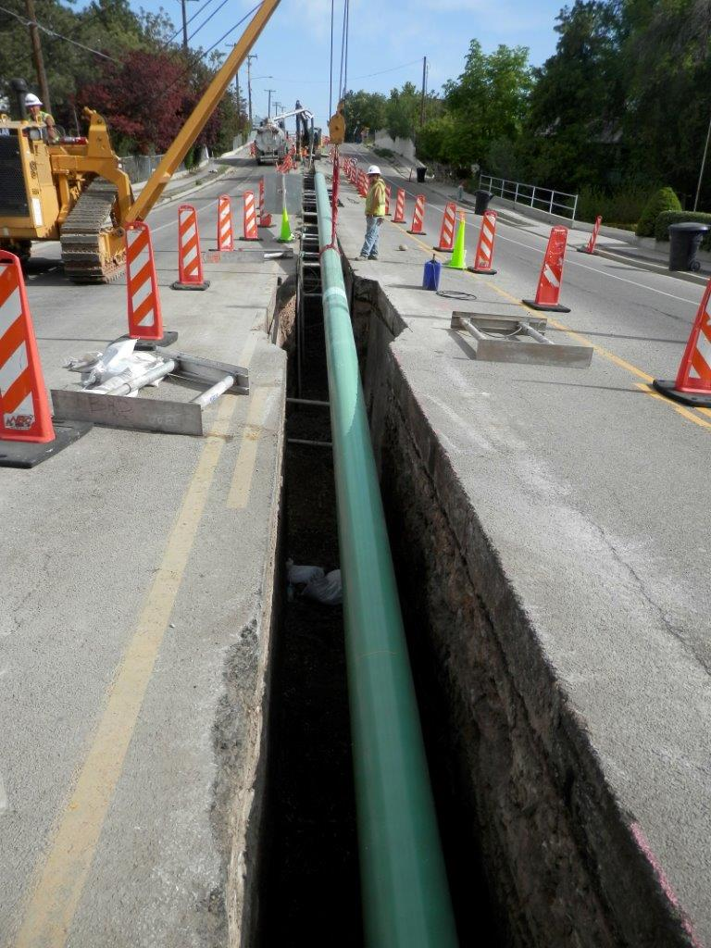
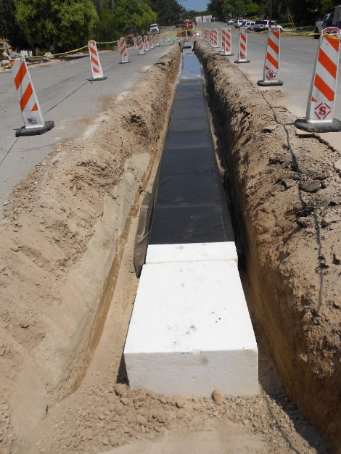
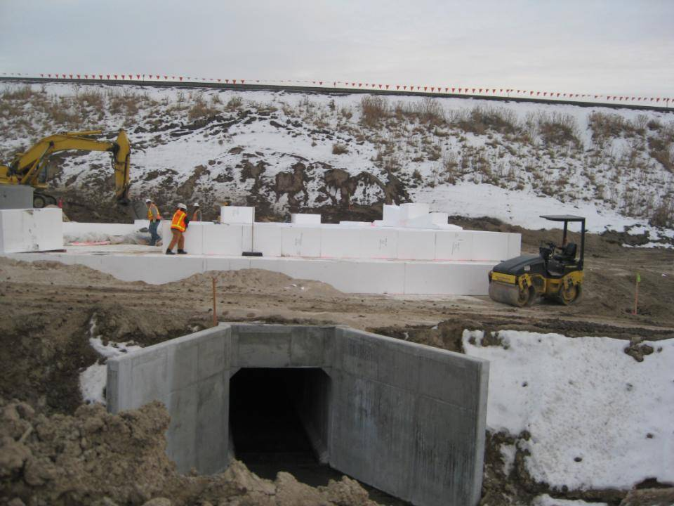
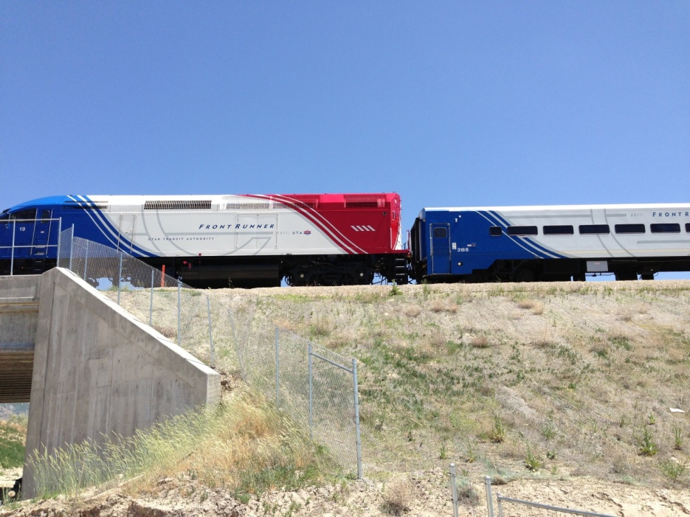
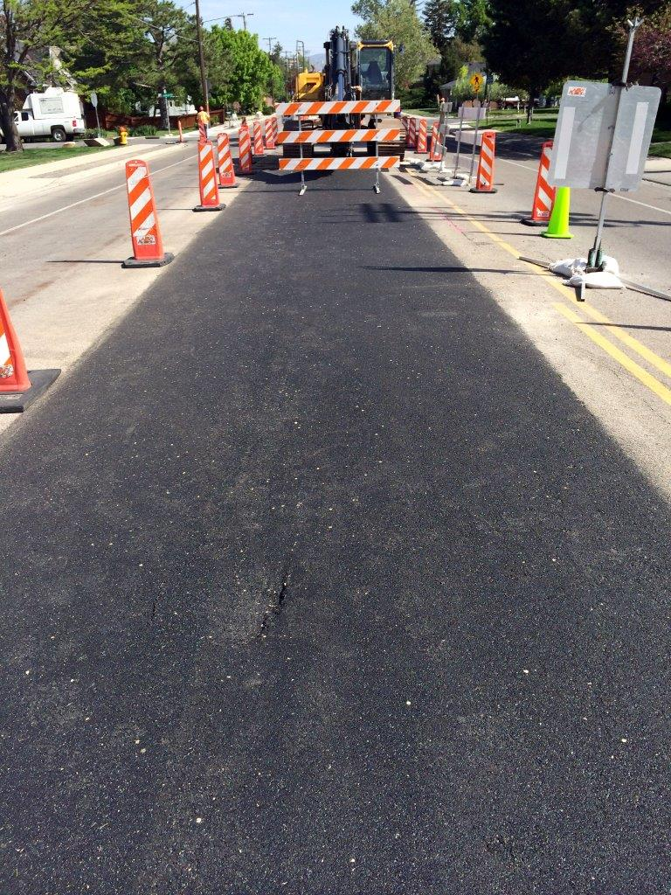

Reduction of load on Utilities and Pipelines

Slide 25


Bridges appearing in the night?

Slide 26
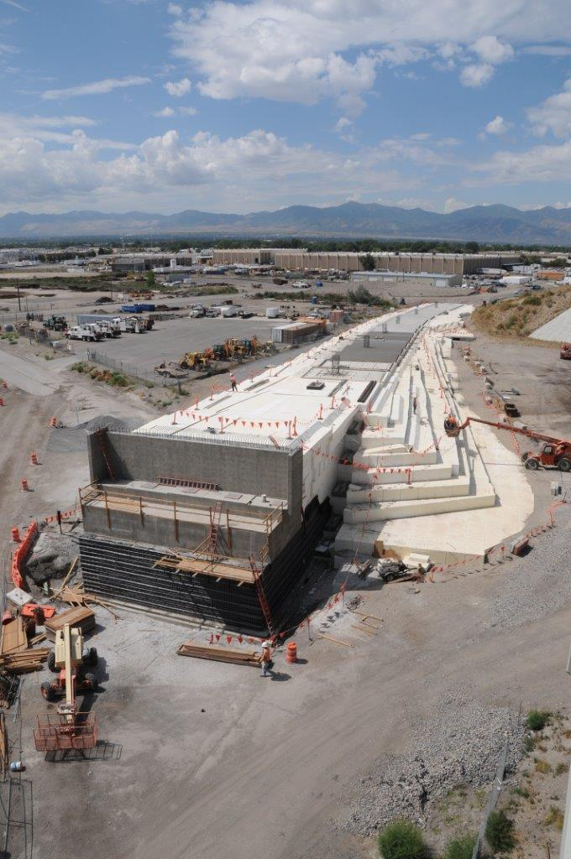
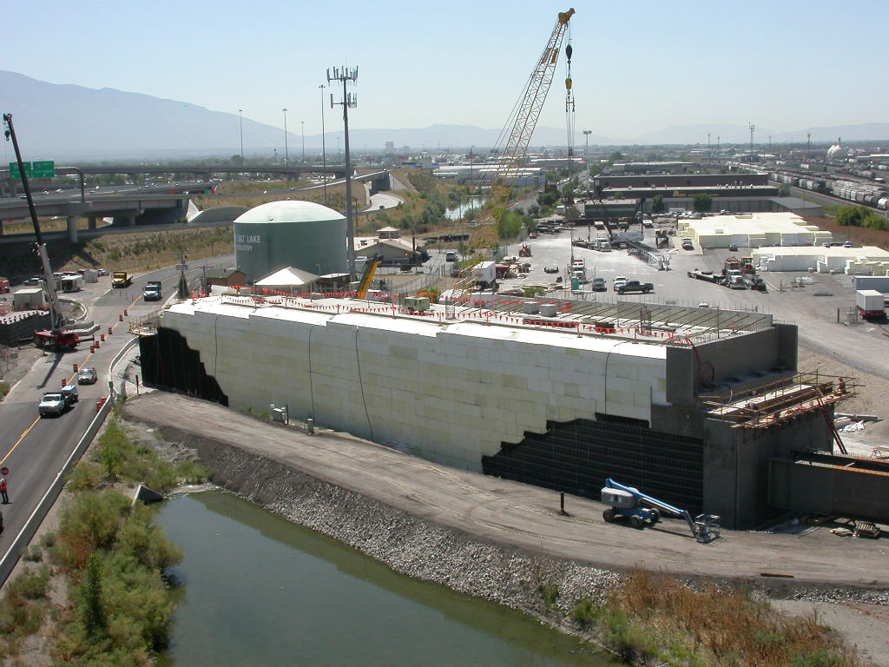
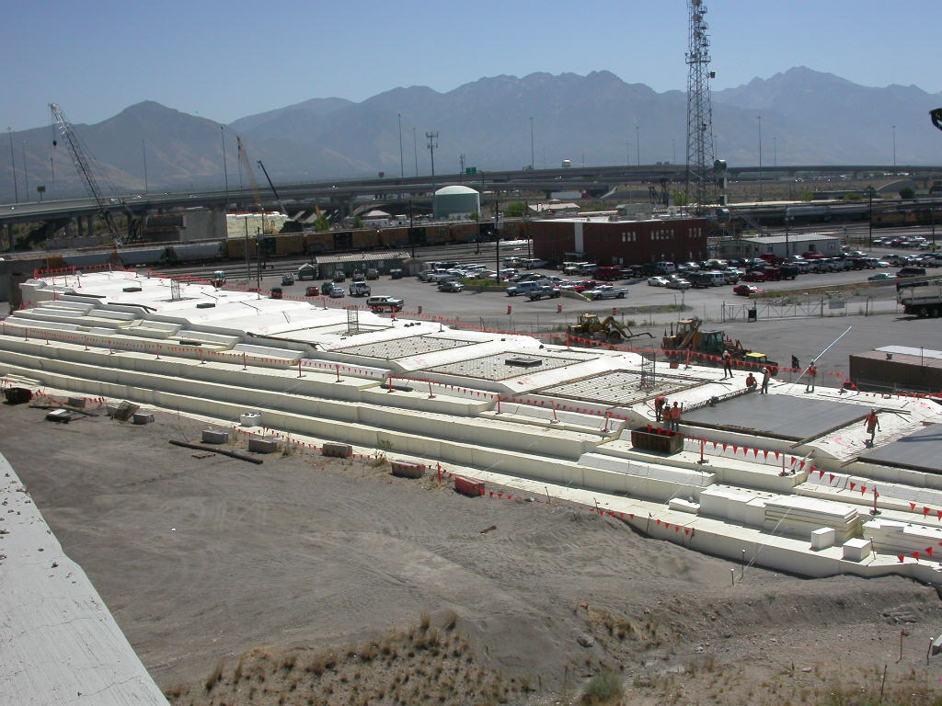
Bridge approach fill
UTA Light and Commuter Rail – Salt Lake Valley, Ut

Slide 27
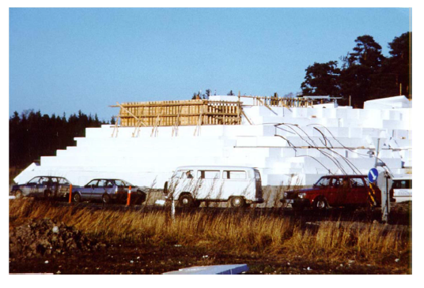
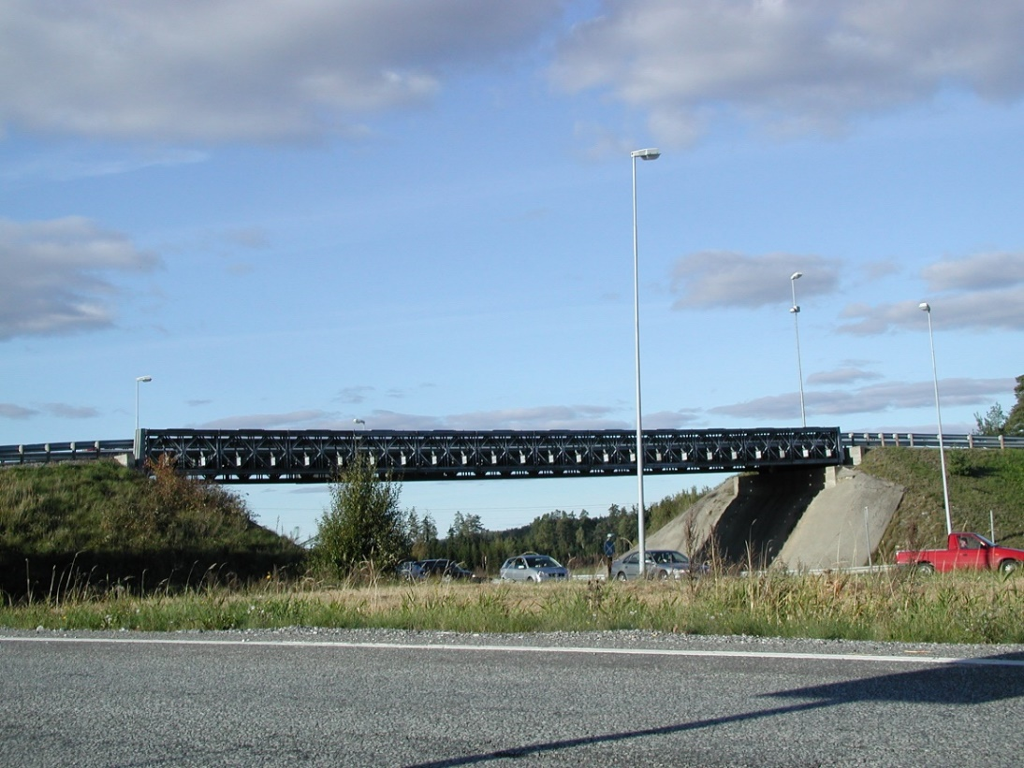
Accelerated Bridge Construction
Lokkeberg Bridge,
Norway

Slide 28

Acceleration Bridge Construction
Pavement
Truss or Modular Bridge
Bridge Footing
Geofaomblocks
Seismic Restraint System
Soft Soil
Excavation
Concrete Slab

Slide 29

Atlantis Reborn?

Slide 30
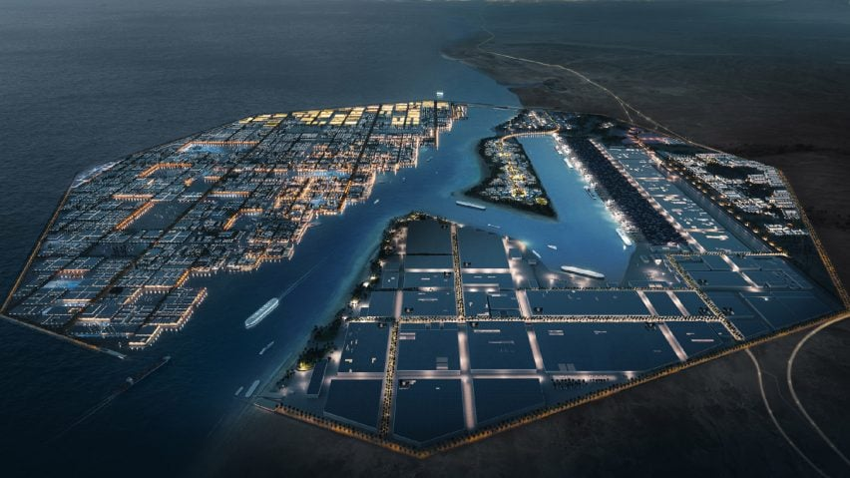

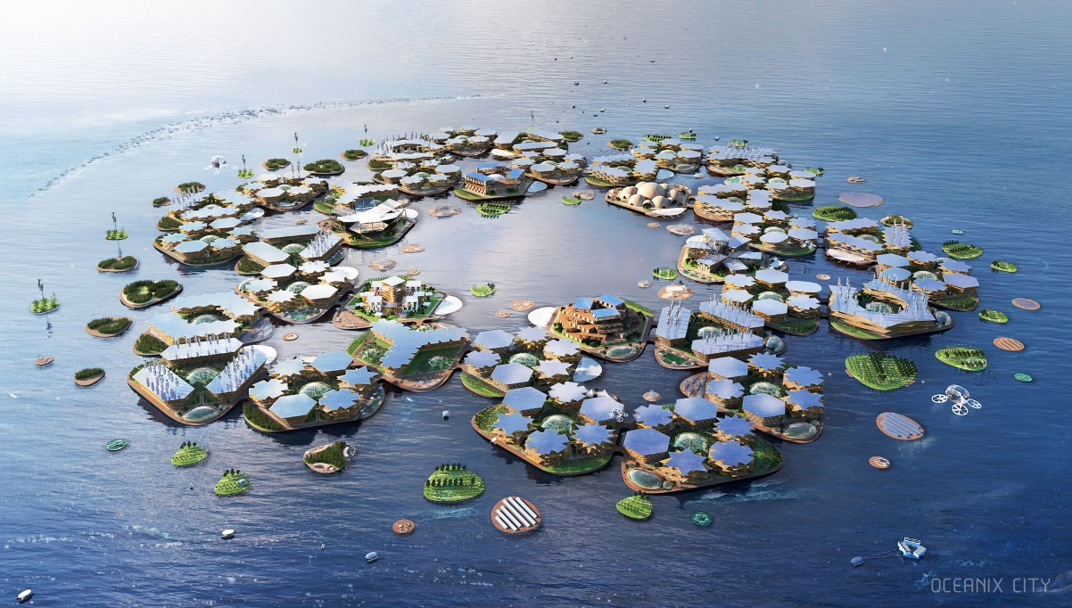
Floating cities
Oxagon, Neom, Saudi Arabia
Oceanix City, Busan, S. Korea

Slide 31
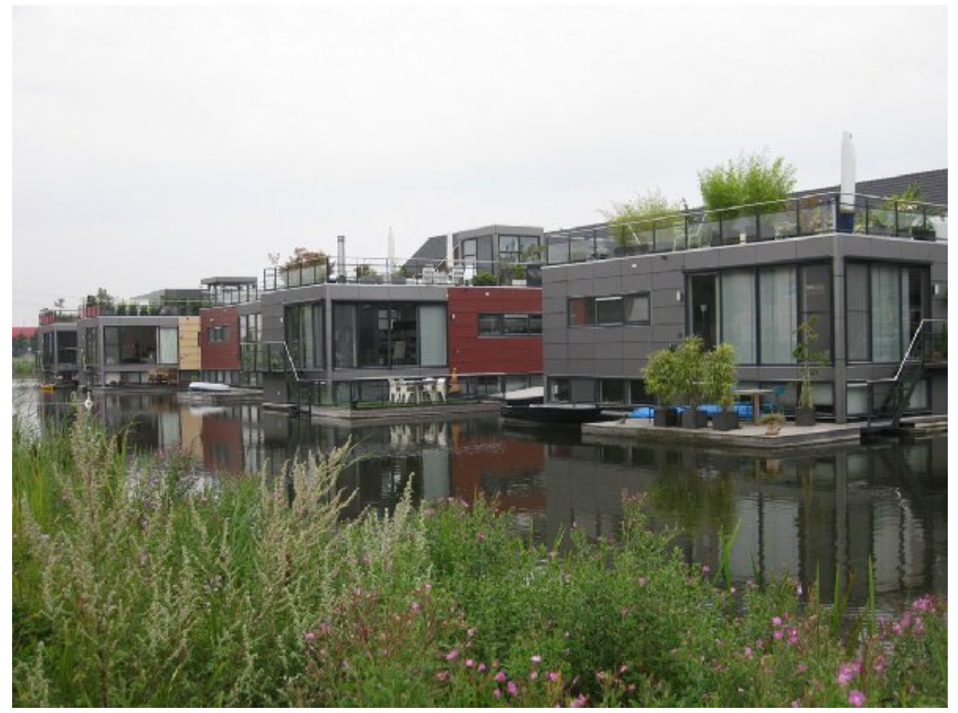
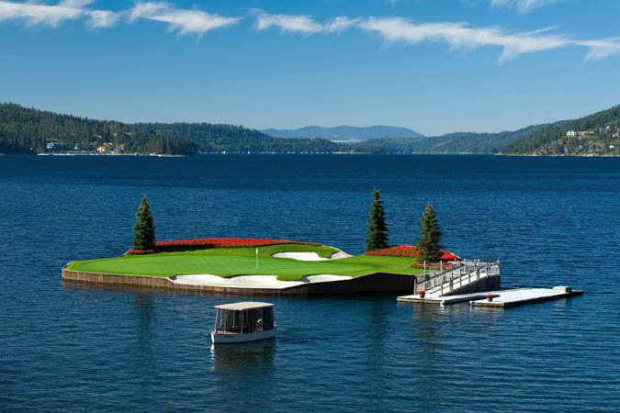

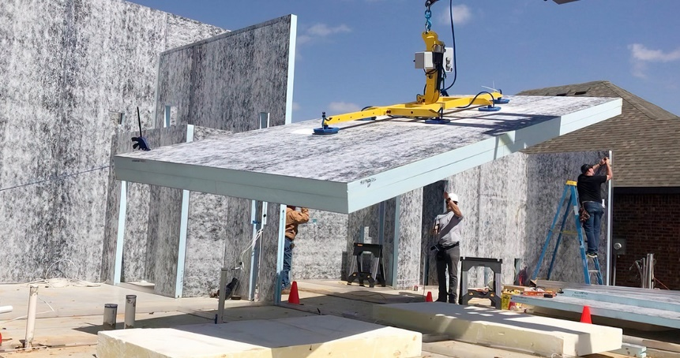
Floating Platforms and Buildings
Structural insulated panel
With polystyrene core
SIPs can be up to 70 percent more energy efficient than conventional buildings
SIP Construction

Slide 32
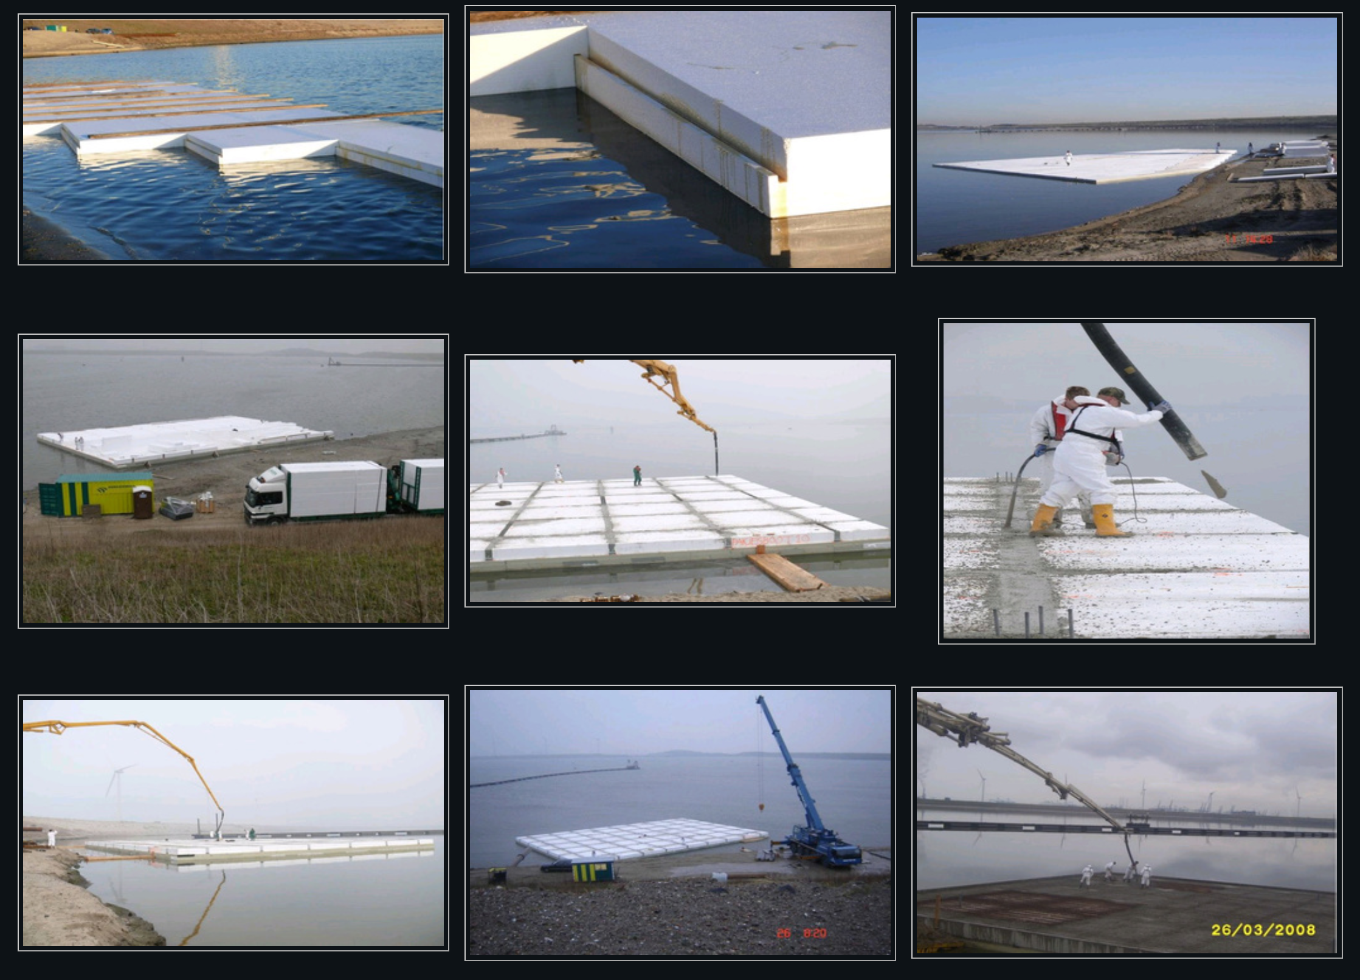
Construction of Floating Platforms
http://amphibioushomes.weebly.com/floating-foundations--bases.html

Slide 33
Material and Construction Considerations
Buoyancy can be minimized by installing geofoam above the water table and ensuring suitable drainage. In addition, it can be counteracted by placing overlaying soils, pavements, sidewalks to sufficiently offset uplift forces resulting from buoyancy.
Chemical resistance - EPS geofoam does not decompose nor is affected by road salts. Petroleum products and other chemicals can damage EPS, so incorporation of protective layers or barriers is used (e.g., soil cover, concrete slabs, geo-membranes, etc.).
Flammability - EPS is combustible when exposed to an oxygen source, so it is important to cover with non-flammable materials (i.e., soil, etc.) and include a flame retardant. Geofoam is usually isolated by membranes, soils, or pavement in the finished application.

Slide 34
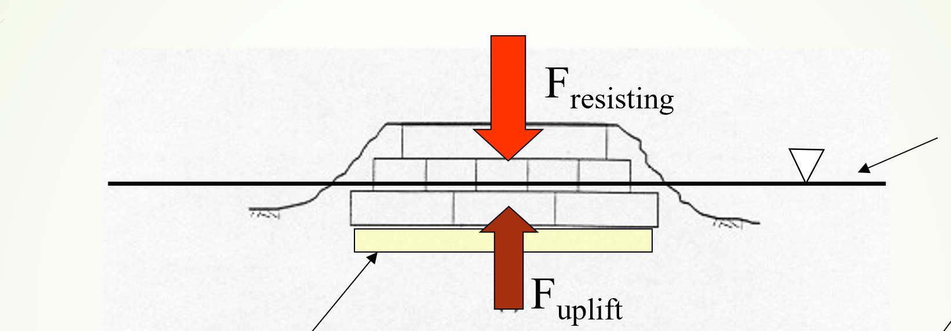
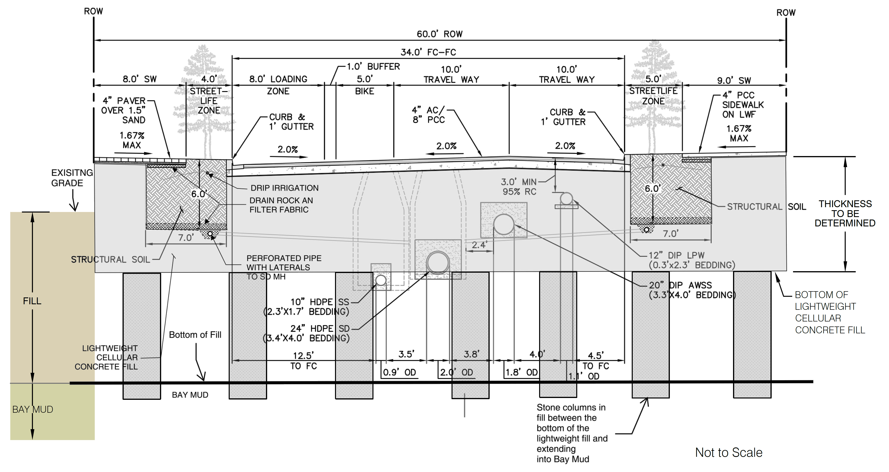
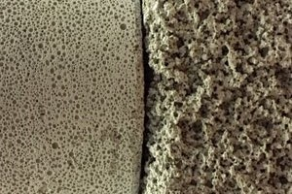
bUOYANCY considerations
Option 1 - Use weight of EPS cover
Maximum groundwater level
Option 2 - Use permeable cellular
concrete or granular material
below the water table
F resting > 1.2 F uplift

Slide 35
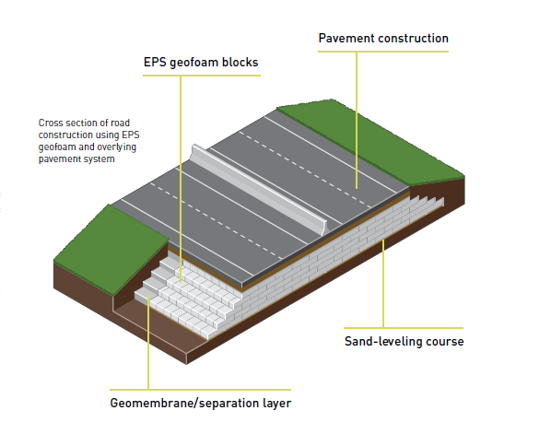

Chemical Resistance considerations
The possibility of petroleum spill is less because heavy truck and vehicle traffic is not present.
The consequences of potential damage to the EPS are less because landscaping applications are less critical than roadway applications.
Method 2 – Vertical Embankment with concrete Load Slab and Precast ConcretePanels
Note Federal Highways Administration will accept either method
Method 1 – Sloped Embankment
With Geomembrane Separation Layer
I-15 Reconstruction Geofoam Task Force Team

Slide 36

Schedule Comparison

Slide 37

Cost Comparison
The above costs do not include utility relocation costs.
If utilities are present then geofoam is the low cost alternative

Slide 38

Flammability considerations
Ordinary Expanded Polystyrene is a combustible material and will bum when set on fire. For this reason some precautions should be taken when constructing EPS fills using the normal quality material. Such precautions may include fencing in any stockpiles on site and provide round the clock guards, or place the blocks directly inn the fill as they arrive on site, working round the clock shifts if necessary.
Alternatively a self-extinguishing quality of EPS may be used at approximately 5 % increase in productions costs. Once the EPS is covered by the pavement material on top and soil on the side slopes, however, there will not be sufficient oxygen available to sustain a fire.
Two failures due to fires have occurred in Norway and were caused by welding activities on bridge abutments adjacent to EPS fills during the construction phase. . . . So the fire potential should not be overlooked and in some counties in Norway the local highway offices are using self-extinguishing material at the somewhat higher cost in order to exclude fire hazards. A third fire incident is reported from Japan. (Proceedings of EPS 1996 – Japan)

Slide 39





Flammability considerations
Step 1 – Use Flame Retardant Additive
Step 2 - Construction Precautions
Step 3 – Cover/Incapsulate Block

Slide 40
Awards
ASCE 2002 Outstanding Civil Engineering Achievement (OPAL) Award,
Wasatch Constructors I-15 Reconstruction Design-Build Team, Salt Lake City,
Utah
ACEC Arizona 2006 Grand Award, Rockfall Containment and Safety,
SR 264 at 2nd Mesa, Arizona
ASCE 2010 Local Outstanding Civil Engineering Achievement Awards,
Geotechnical Category – Outstanding Award SR 519 / I-90 to SR 99,
Intermodal Access I/C Improvements Phase 2 Design Build Project
Seattle, Washington
Rebuilding America’s Infrastructure Magazine 2012,
Best of America’s Infrastructure – Cost Saving Approaches,
Geofoam Embankments, UTA TRAX line, Salt Lake, City, Utah

Slide 41











Partners

Slide 42


Resources
https://www.geofoam.com/?pdf=EPS-Geofoam-Applications-Technical-Data.pdf&id=968
https://www.springerprofessional.de/en/5th-international-conference-on-geofoam-blocks-in-construction-a/15790828?tocPage=1
Authors: Stark, Bartlett and Arellano, 2012

